Slide 3
Notes:
EXP
Listen to My God is So Big arranged by Phil Davidson.
VOY
Listen to a song that expresses wonder at God’s creation - For example Indescribable by Chris Tomlin (https://www.christomlin.com) or My Best Friend by The Lads.
Say: Music is a wonderful way in which we can express how we feel. This song expresses how the songwriter feels about God.
Listen to the song.
Ask: How does this songwriter feel about God? (Accept responses).

Slide 4
Notes:
Ask: Who likes to watch the clouds in the sky?
Say: I like to look at the shapes that the clouds make and imagine that I’m seeing an animal.

Slide 5
Notes:
Ask: What shapes do you see?

Slide 6
Notes:
Ask: What shapes do you see?

Slide 7
Notes:
Link: Isn’t it amazing that there are so many cloud shapes! There was a king in the Bible called David. He liked to look at the skies but rather than thinking about what animals the clouds look like, David thought about who made the clouds.

Slide 9
Notes:
Ask: What did Jeremiah discover about God?
Link: There was another man in the Bible called David. Let’s see what he discovered about God when he looked at what God had made.

Slide 11
Notes:
Ask: What do you see?
Ask: What do you think is going on? What might the person be thinking or feeling?
Ask: What does it make you wonder about God?
Link: There was a king in the Bible called David. He looked up at the skies and he discovered something wonderful about God.

Slide 12
Notes:
Link: The Bible teaches us that we can learn about what God is like from what he has made.

Slide 13
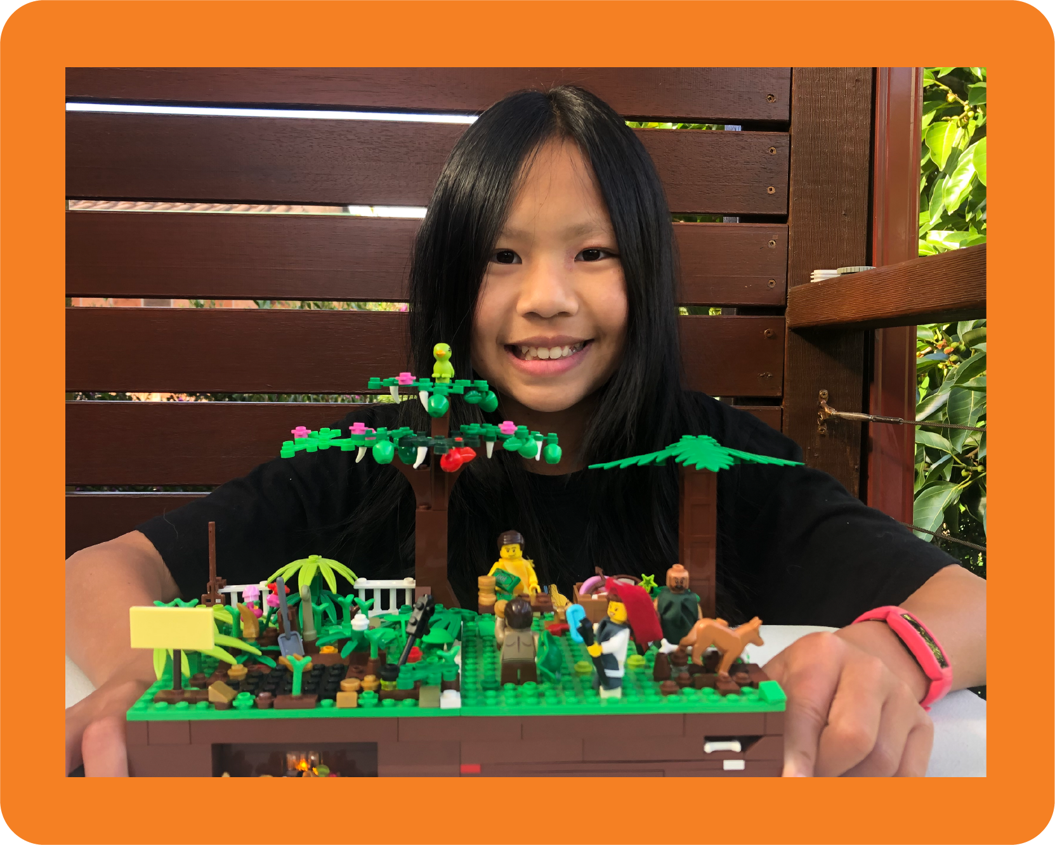
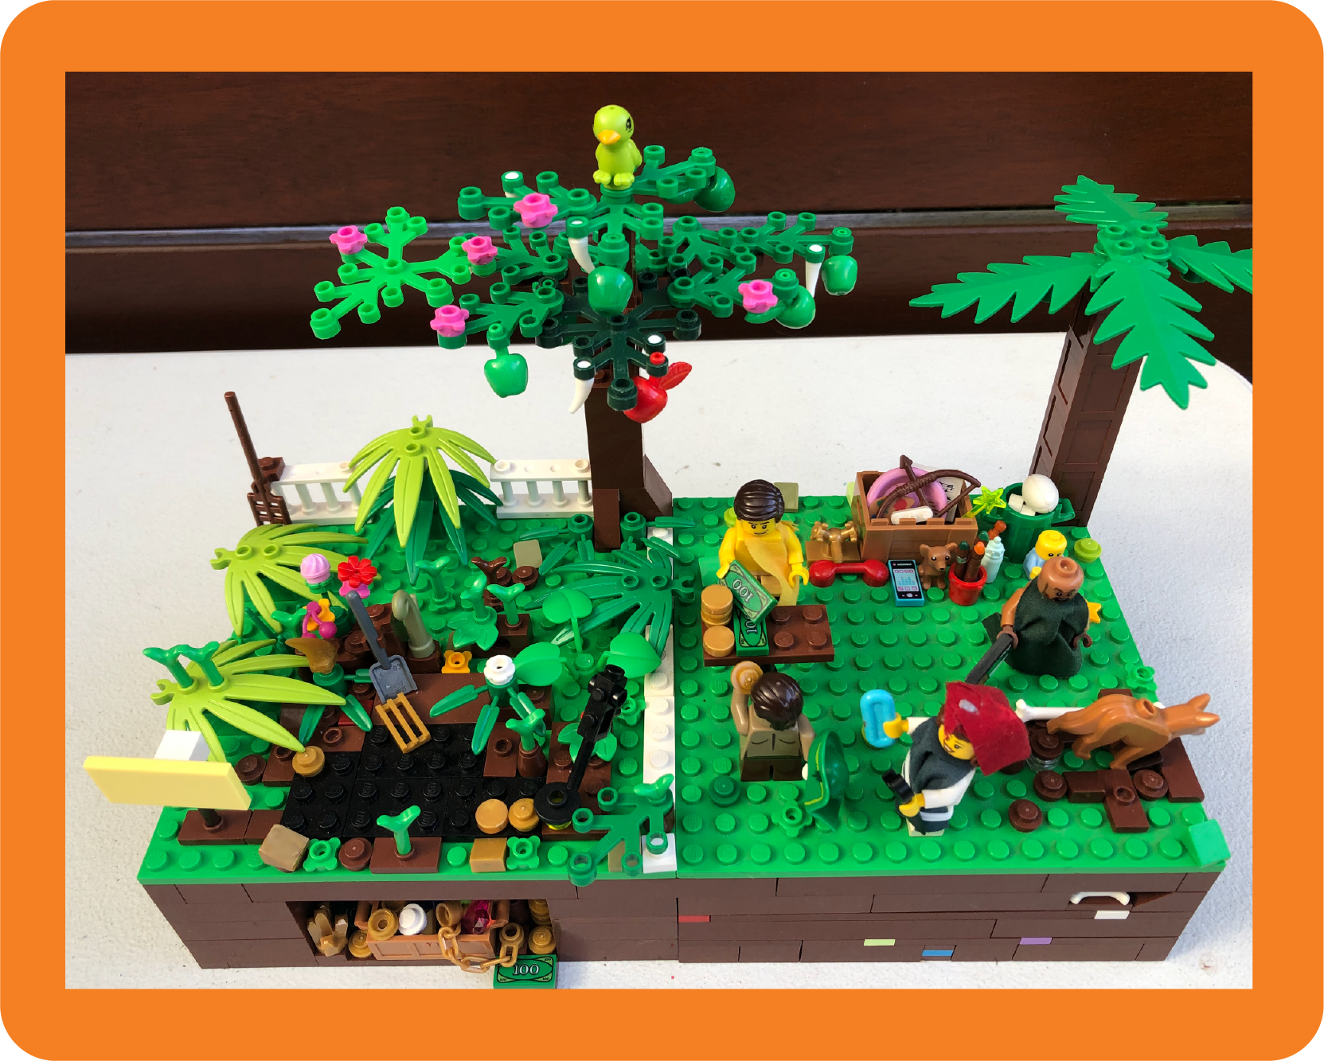
Notes:
Ask: What can we know about the person who made this work? How can we tell?
Click to reveal the maker, Eva.

Slide 14
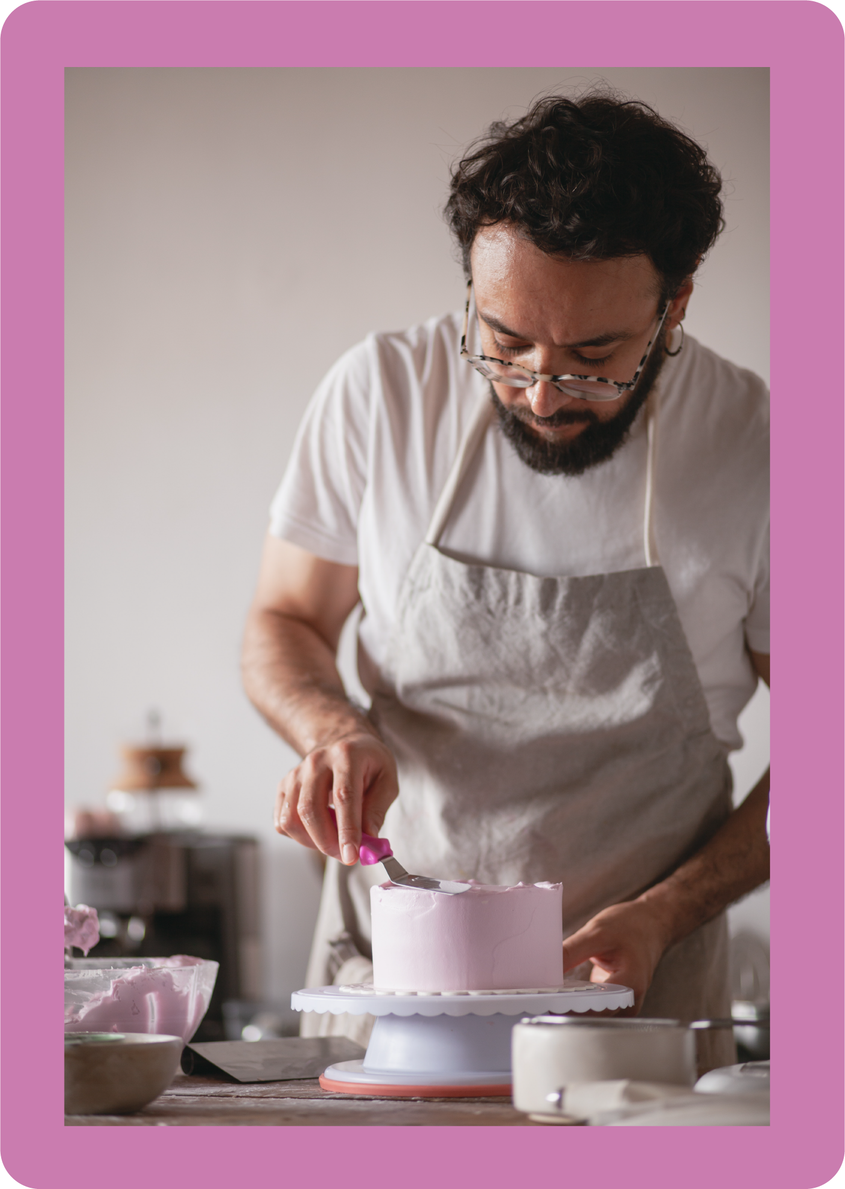
Notes:
Ask: What can we know about the person who made this work? How can we tell?
Click to reveal the maker.

Slide 15
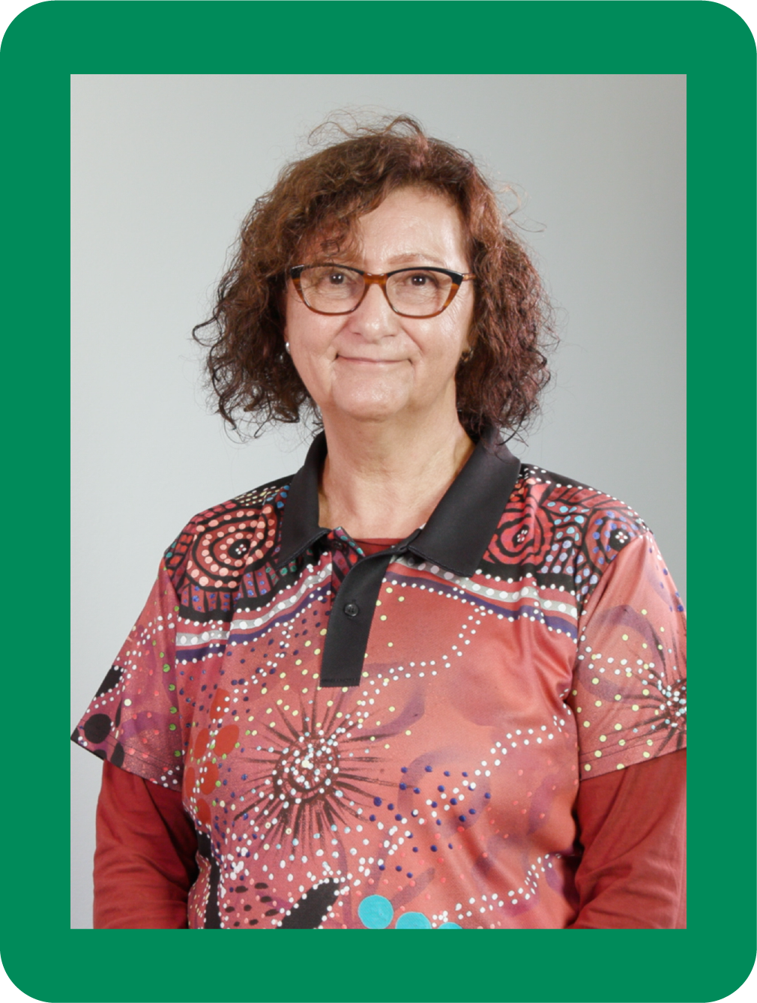
Notes:
Ask: What can we know about the person who made this work? How can we tell?
Click to reveal the maker. Aunty Fern Martins is an aboriginal artist.

Slide 16
Notes:
Ask: What can we know about the person who made this work? How can we tell?
Click to reveal God

Slide 17
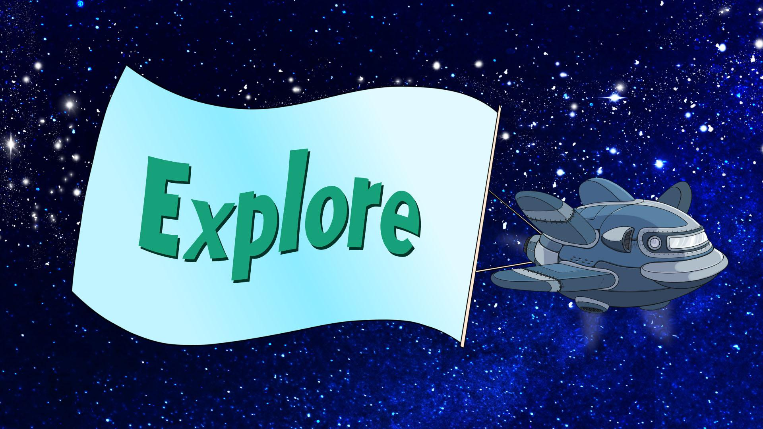

Slide 19
Notes:
Say: In the Bible, there was a king called David who had discovered a lot about God, in fact he felt he knew God well. When David looked up at the skies, he said, ‘The heavens tell about the glory of God. The skies show that his hands created them.’
David believed that God made everything and as he enjoyed what God made, he discovered how wonderful God is.

Slide 20
Notes:
Ask: How would you describe what God has made? What must God be like?

Slide 21
Notes:
Ask: How would you describe what God has made? What must God be like?

Slide 22
Notes:
Ask: How would you describe what God has made? What must God be like?

Slide 23
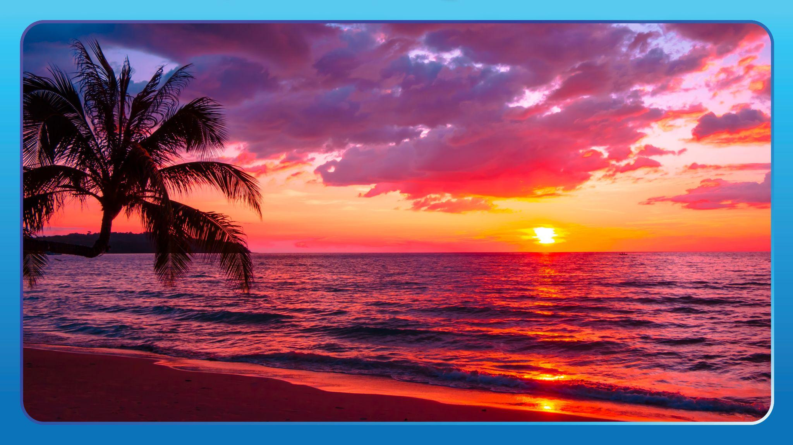
Notes:
Ask: How would you describe what God has made? What must God be like?

Slide 24
Notes:
Ask: How would you describe what God has made? What must God be like?
Say: God is an amazing creator and we can know something about him by just looking up!

Slide 25
Notes:
Insert Psalm 19 Video.
Watch the Psalm 19 video. Say: These words are from a book in the Bible called Psalms. This psalm is written by King David who discovered something so amazing about God that he wanted others to sing about it.
David had spent time enjoying what God had made. When he looked up into the skies, something that amazed David was how the sun travelled across the sky, giving heat and life to the earth for everyone to feel. Not only that, the sun always rises and sets, giving order to days and nights. It made David realise how wonderful God is as a creator.
Let’s listen to the Bible verses again.
Read Psalm 19:1-4,6
Ask: What can we learn about God from what he has made?
If God made the skies and everything in it, how does that prove that he can do anything?

Slide 26
Notes:
Say: Who has visited an art gallery?

Slide 27
Notes:
Say: People often go to art galleries so they can look at and enjoy amazing works of art, like sculptures or paintings or installations.

Slide 28
Notes:
Say: Sometimes, if you look carefully at the work of art, you can even see the artist’s signature.
Ask: Can you spot it? Why do you think an artist includes their signature?
Artists sign their work so that people can know that they are the creator. It also is a way of showing everyone that they’re proud of their work.

Slide 29
Notes:
Say: The Bible teaches that God planned, designed and made everything in this world, just like an artist. This world is like God’s art gallery. Everywhere we look displays something amazing that God has made.

Slide 30
Notes:
Say: It’s as if everything has God’s signature on it.

Slide 31
Notes:
Say: King David looked up into the sky and he marvelled at what he saw. It was like the most incredible painting. The vivid colours of a sunrise and sunset.

Slide 32
Notes:
Say: The swirling patterns of the clouds.

Slide 33
Notes:
Say: The shapes of the moon and stars.

Slide 34
Notes:
Say: In Psalm 19, David wrote, ‘The heavens tell about the glory of God. The skies show that his hands created them.’ David could see God’s signature all over the sky - he could see God’s glory or power and it made him feel so thankful for what God had made.
We too can enjoy what God has made and know that he is a wonderful creator.

Slide 36
Notes:
Say: We’re going to read a book of the Bible called Psalms. Psalms is a collection of prayers, poems and songs written by different people, including King David. David lived around 1000 BC and he discovered something amazing about God as he scanned the skies. As I read, try to make a connection with it. You might connect with another text - it could remind you of a story, movie or song. Or you might connect it with yourself - something that has happened to you. Or you might even make a connection with something that’s happening in the world around. Close your eyes, try to picture this psalm and make a connection.
Read Psalm 19:1-6
Instruct students to raise their hands if they made a text-to-text, text-to-self or text-to-world connection.
Divide students into small groups either according to similar connections or not.
Invite students to share their connections and come back as a class to hear from some volunteers.
Say: As David looked at the sky and marveled at its beauty, he realised that God is a powerful and amazing creator. David wanted to tell others about his discovery.
Optional: Watch the Psalm 19 video to revise the Psalm.

Slide 39
Notes:
Devise some actions or a sequence of movement that represents the verse.
Perform the verse at different speeds.

Slide 40
Notes:
Our God is a Great Big God by Vineyard Kids, arranged by Phil Davidson.
Creator God by Dan Warlow
There is Nothing Our God Cannot Do by Dan Warlow

Slide 42
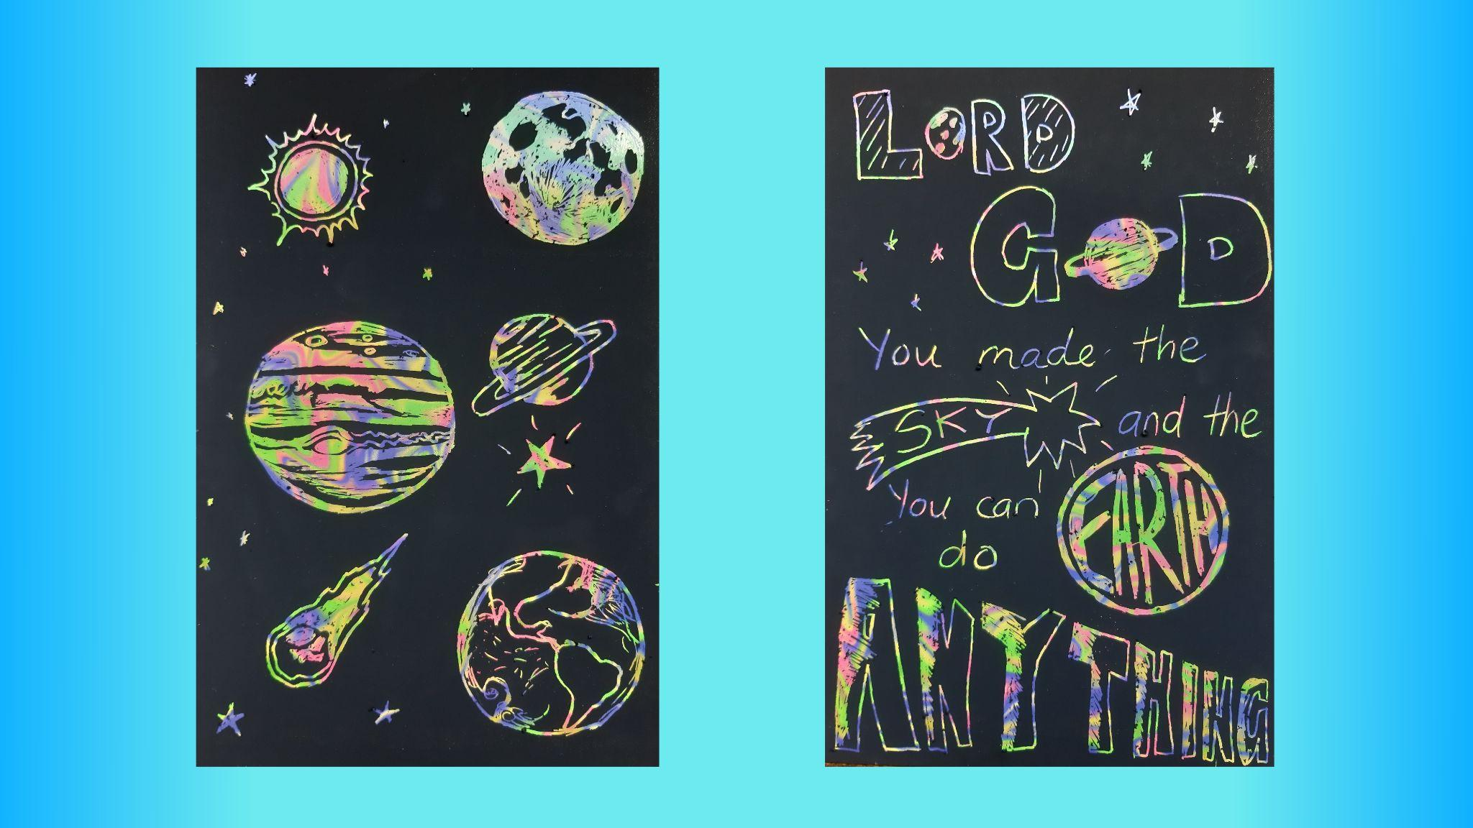
Notes:
Art and craft activity: See Adventurers Lesson 2.

Slide 43
Notes:
The following slides can be used in order or duplicated and called out in the game of bingo. Some words have more than one picture.

Slide 61
Notes:
Say: There was another man in the Bible called Jeremiah. Like David, he believed that God made the sky and earth and it made him realise how powerful God is - that God can do anything.
Devise some actions or a sequence of movement that represents the verse.

