Slide 1
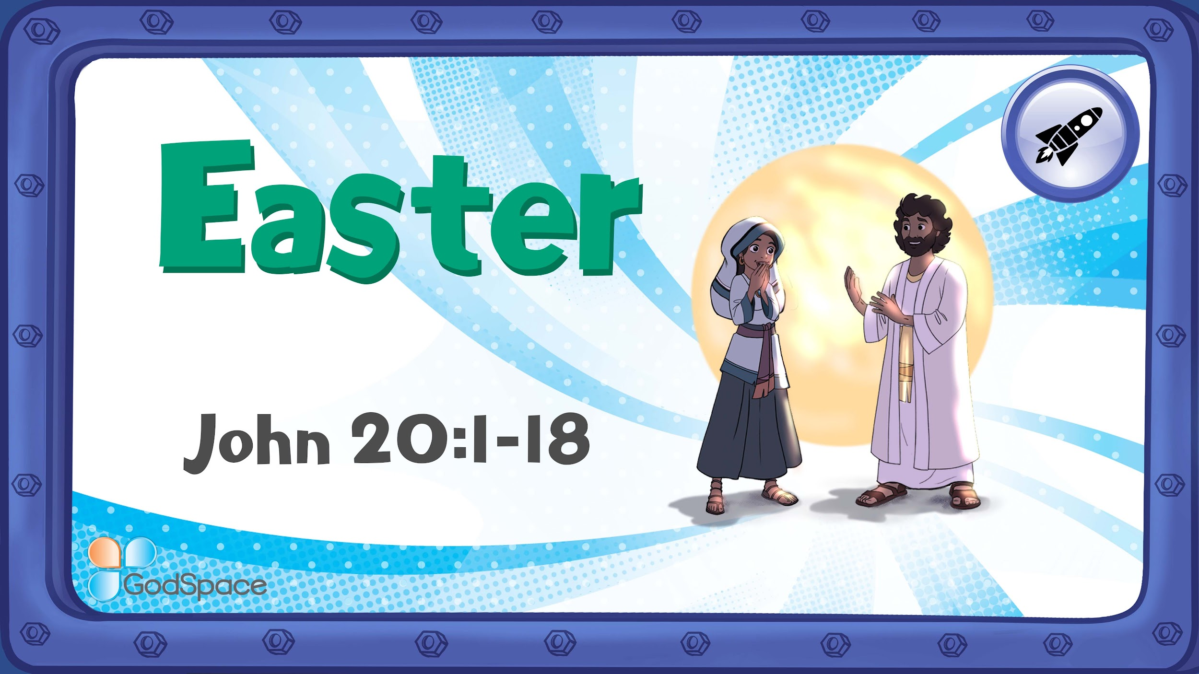

Slide 2
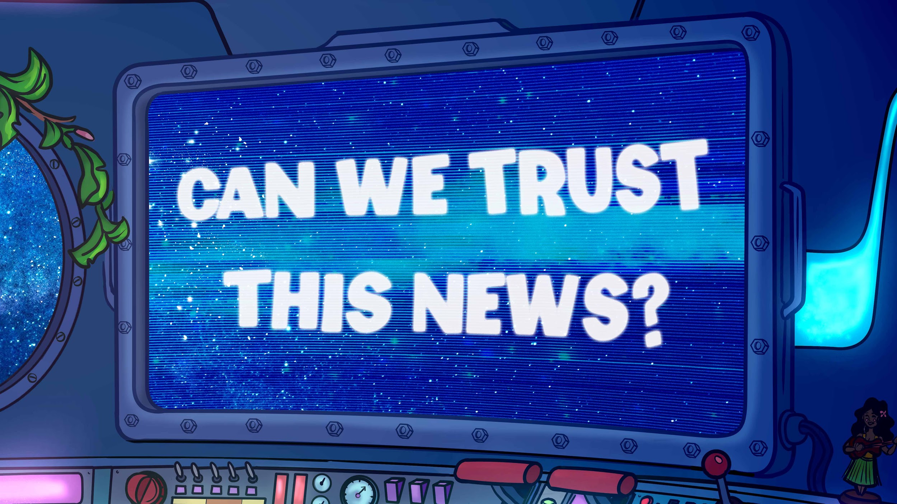
Notes:
Say: I’ve seen some extraordinary things on my phone and I’m trying to figure out if I can trust them or not.

Slide 3
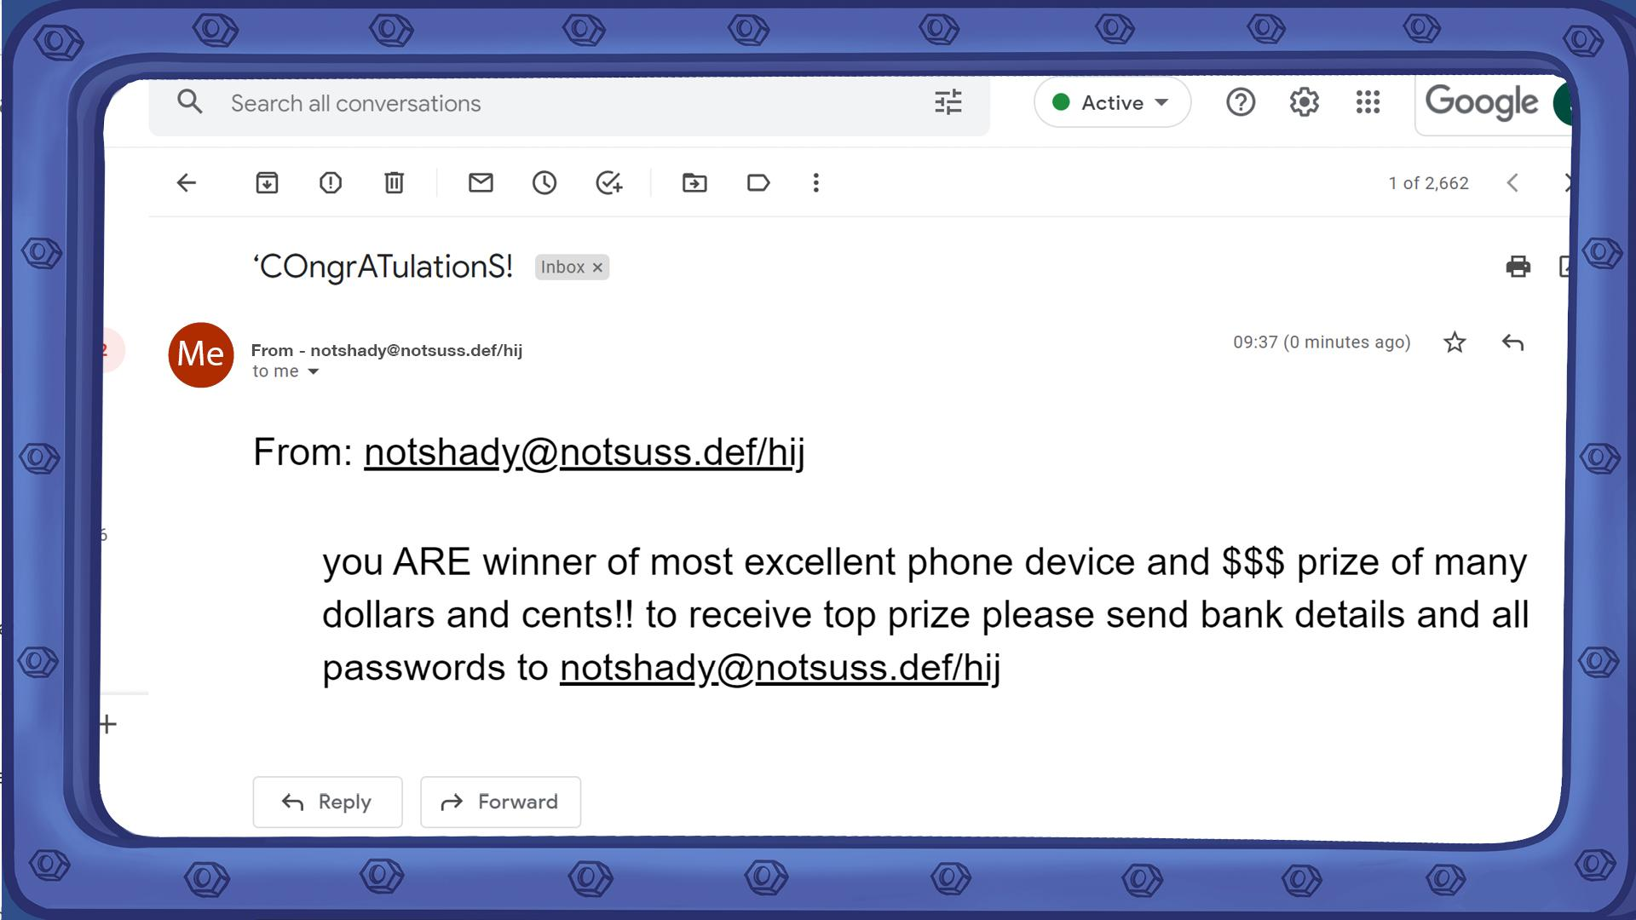
Notes:
Ask: Can we trust this email? (Show fake email) Look at this address! I don’t know who this person is!

Slide 4
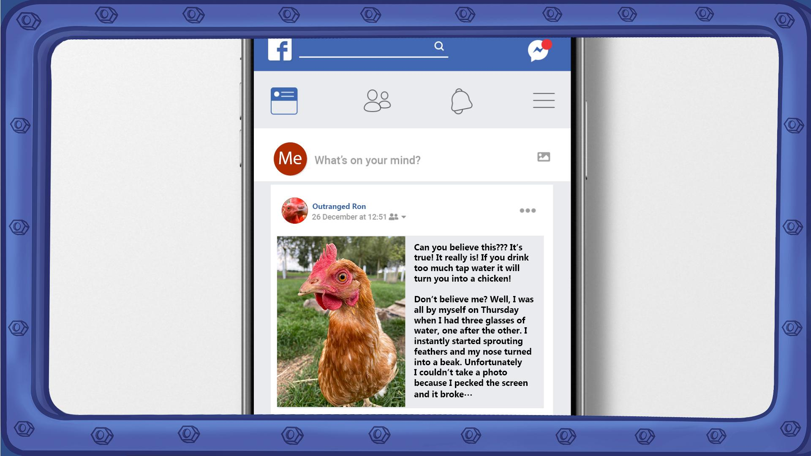
Notes:
Ask: Do you think we can trust this post? (Show post) Only one person saw it happen!

Slide 5
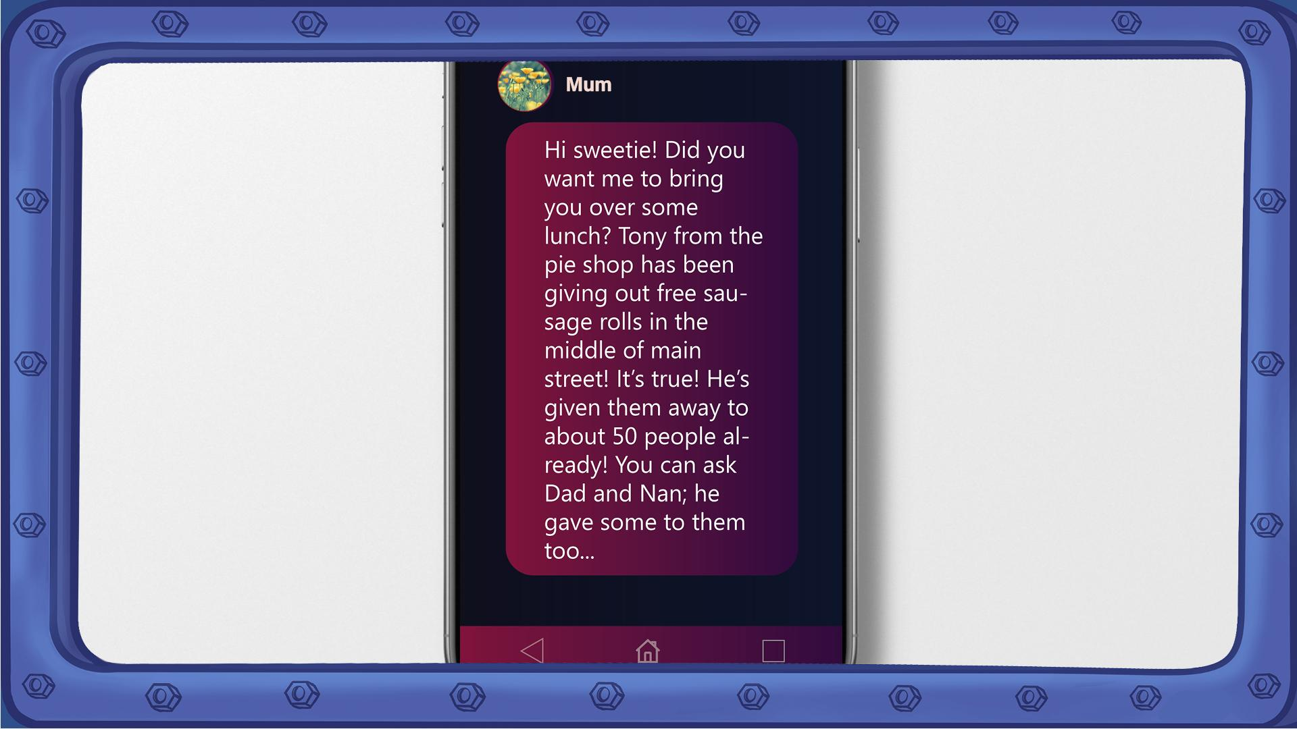
Notes:
Ask: Do you think I can trust this? (Show message) It sounds almost too good to be true, but I think I can trust it. It’s from my Mum – I trust her! It also tells me who I can check with.
Link: Today we’re going to look at messages from the Bible. They might seem almost too good to be true but I trust them.

Slide 6
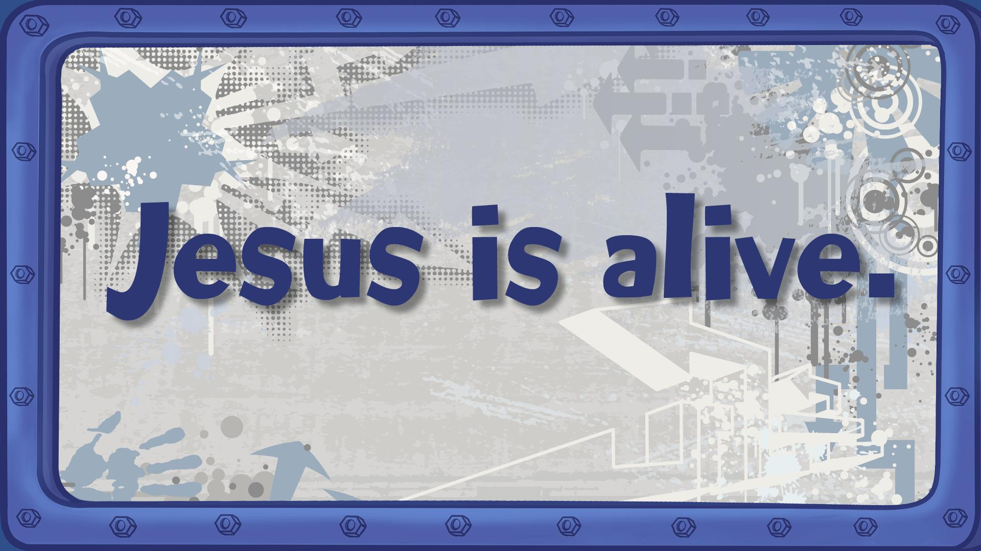
Notes:
Message 1 - Jesus is alive!

Slide 7
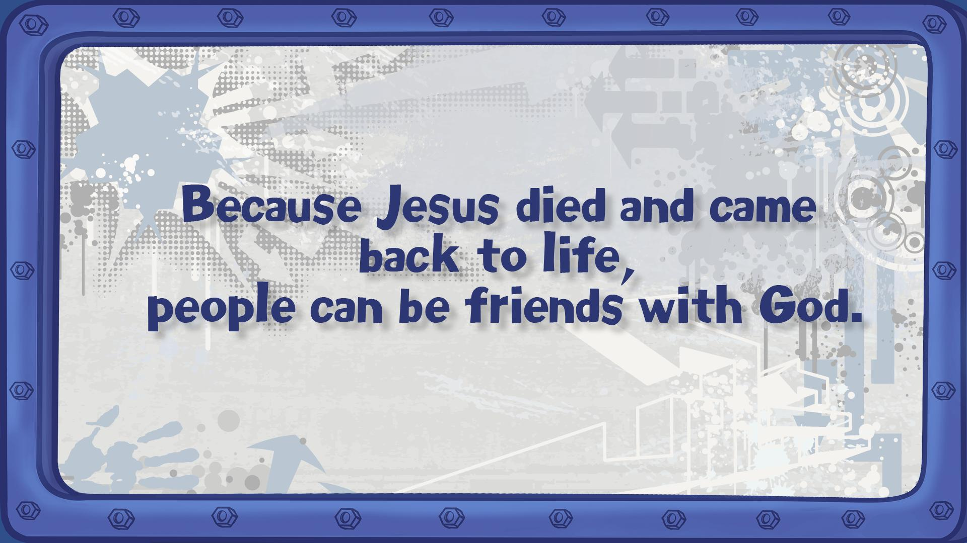
Notes:
Message 2 - Because Jesus died and came back to life, people can be friends with God.

Slide 8
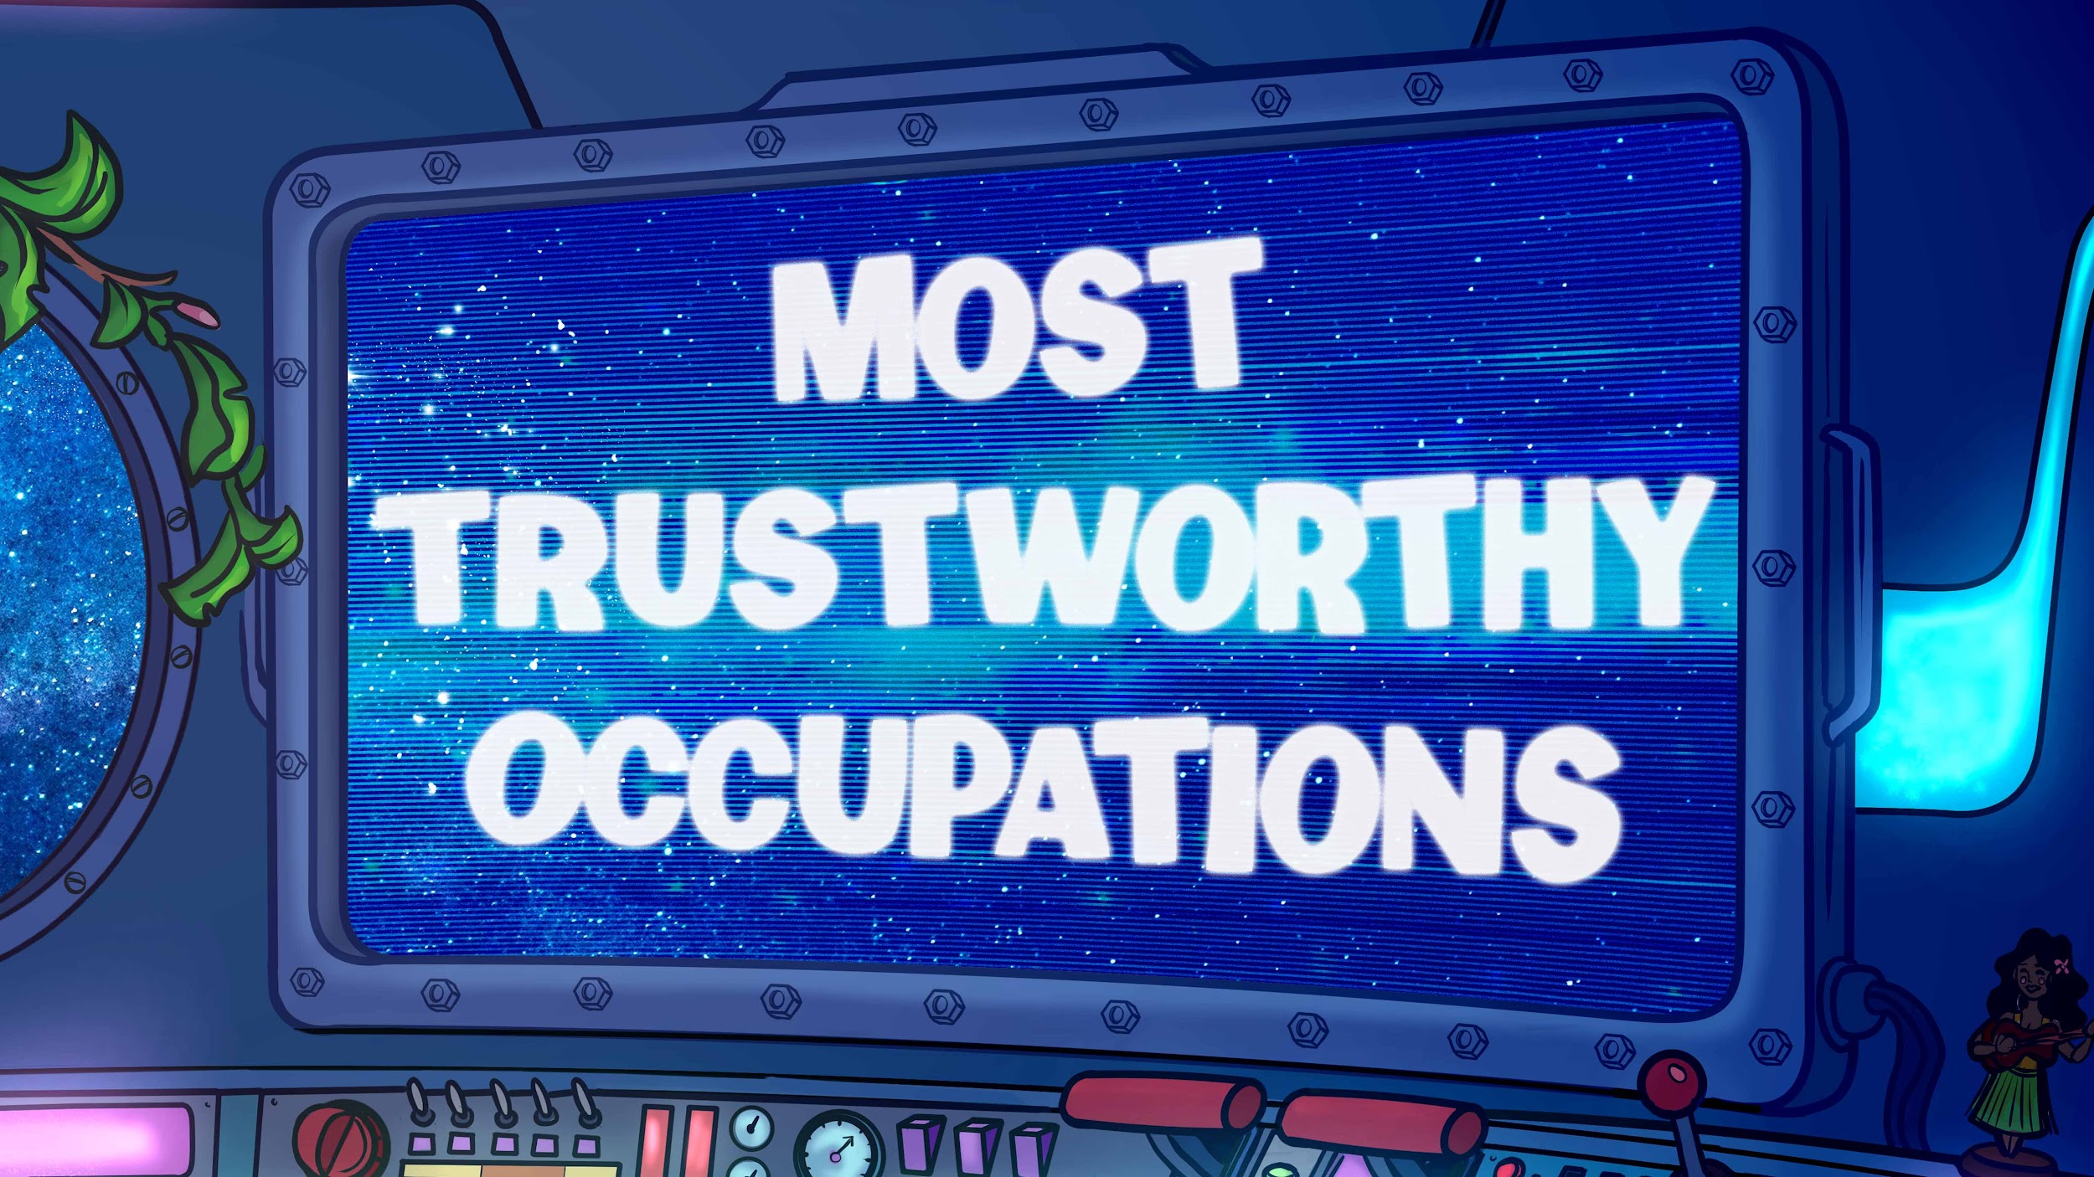

Slide 9
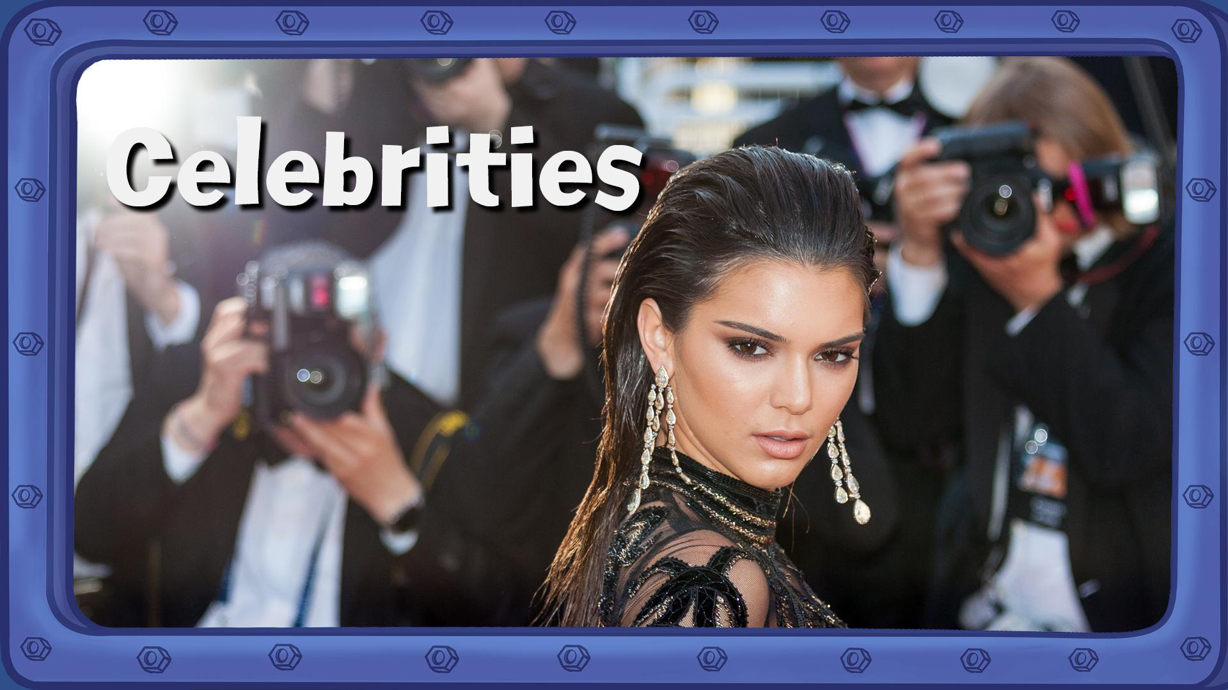
8%
Notes:
What percentage trust celebrities?
(click) 8%

Slide 10

84%
Notes:
What percentage trust police?
(click) 84%

Slide 11
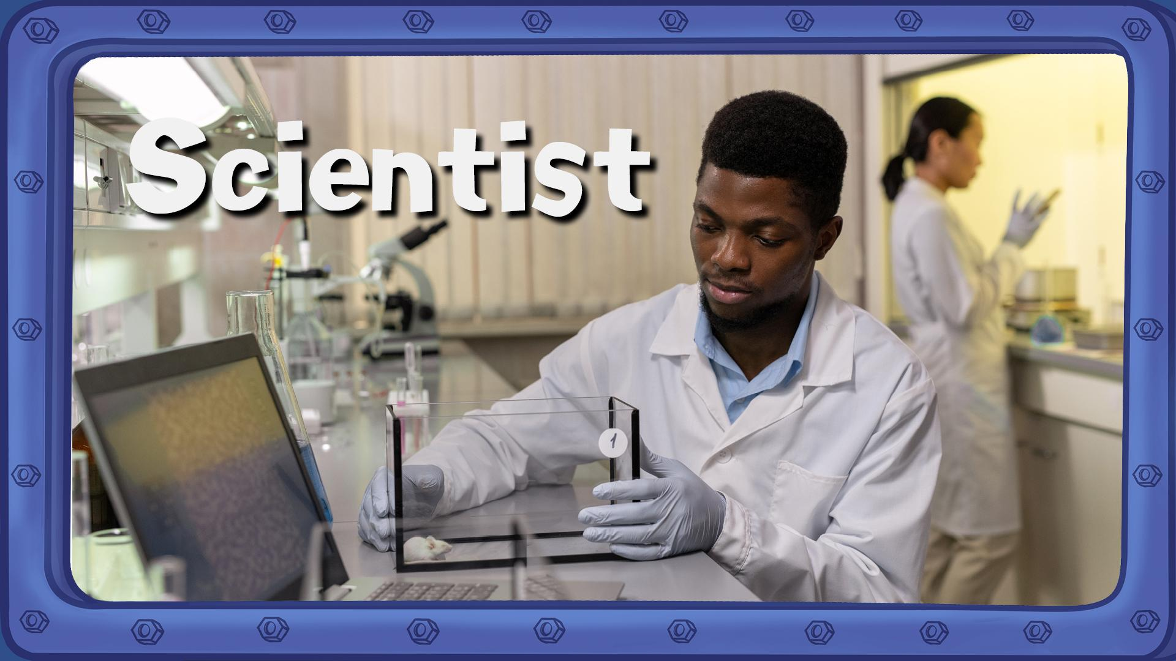
93%
Notes:
What percentage trust scientists?
(click) 93%

Slide 12
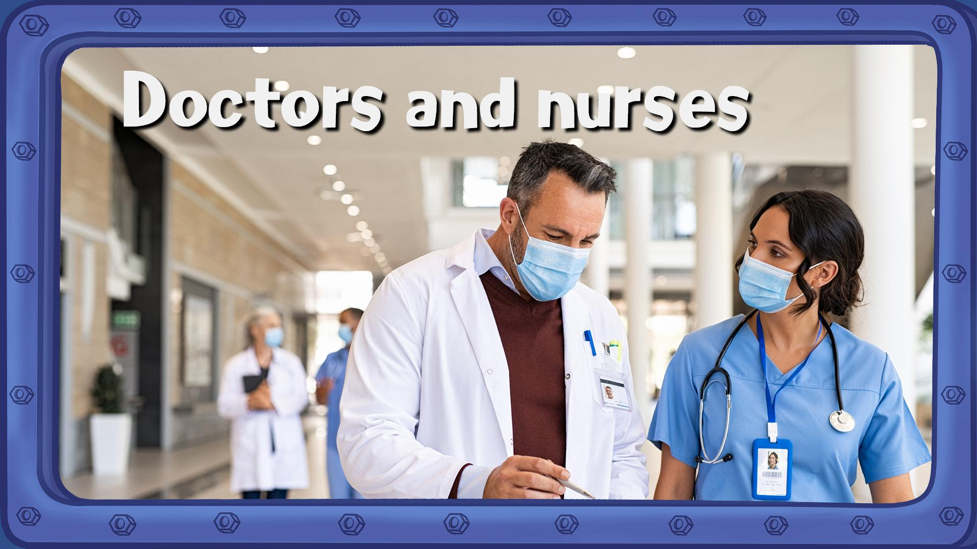
97%
Notes:
What percentage trust doctors and nurses?
(click) 97%

Slide 13
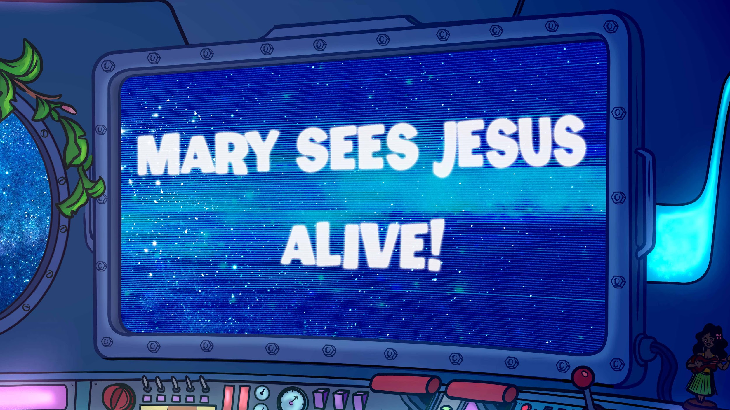

Slide 14
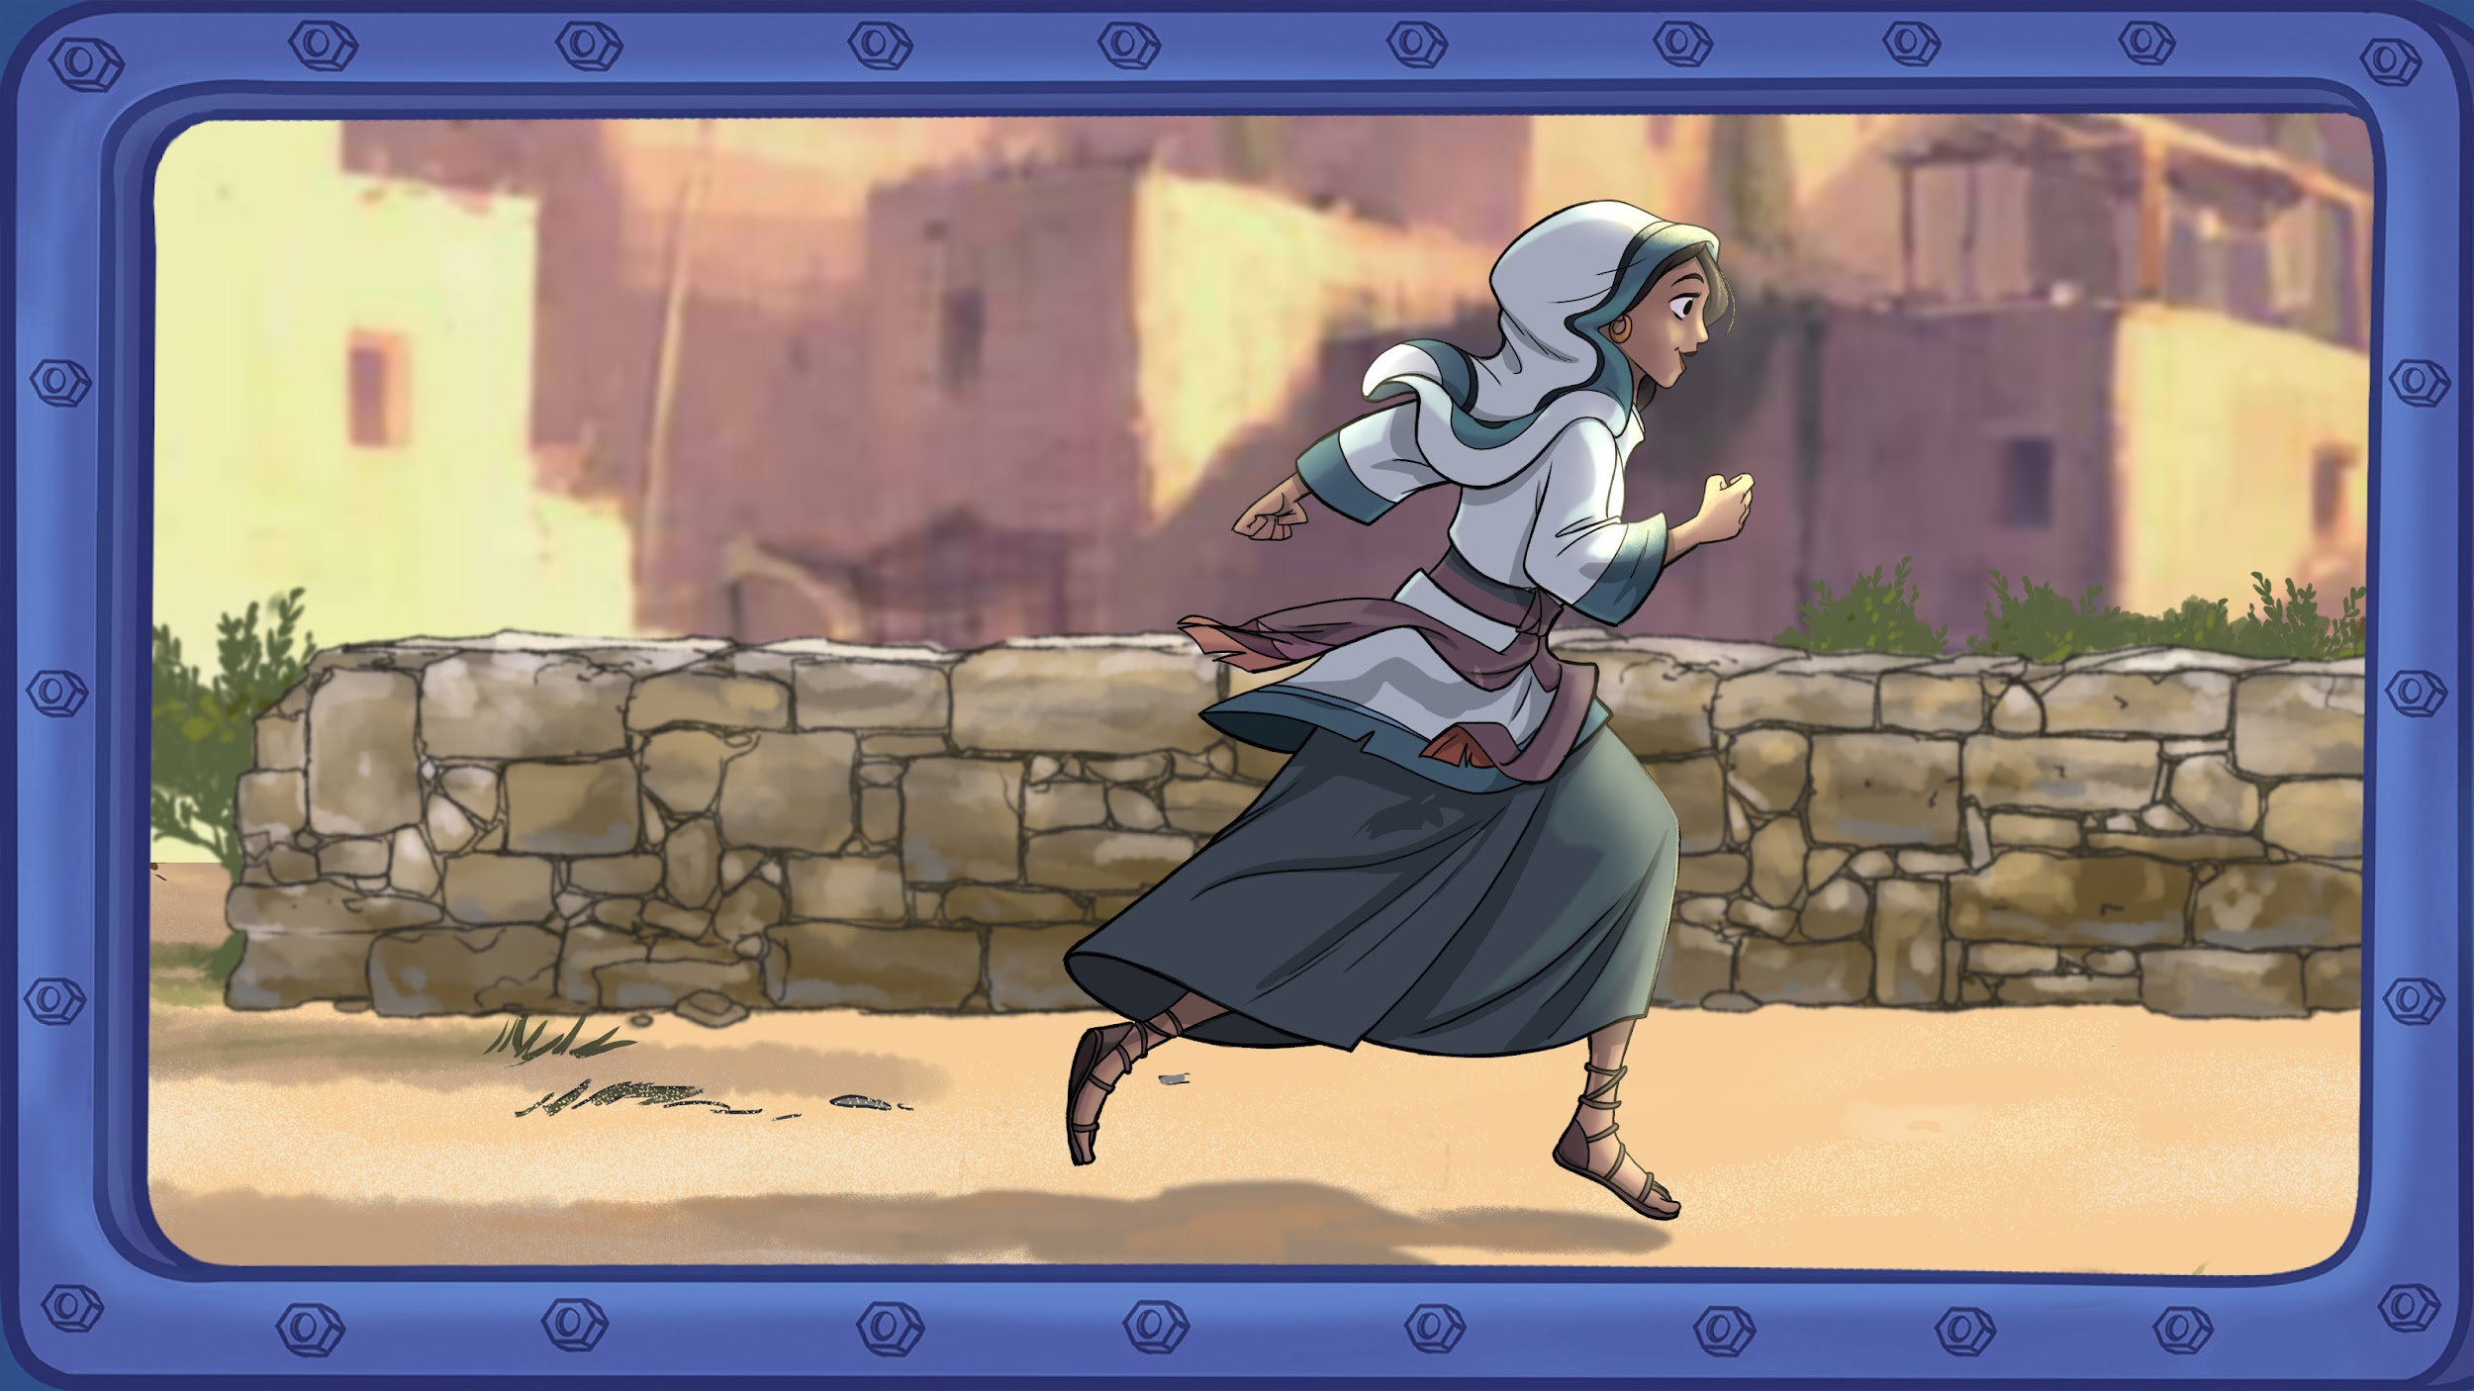
Notes:
Early on Sunday morning, Mary ran to see her friends. She was so happy! She knew what had happened; she had seen and heard for herself - Jesus was alive! She couldn’t wait to tell them.

Slide 15
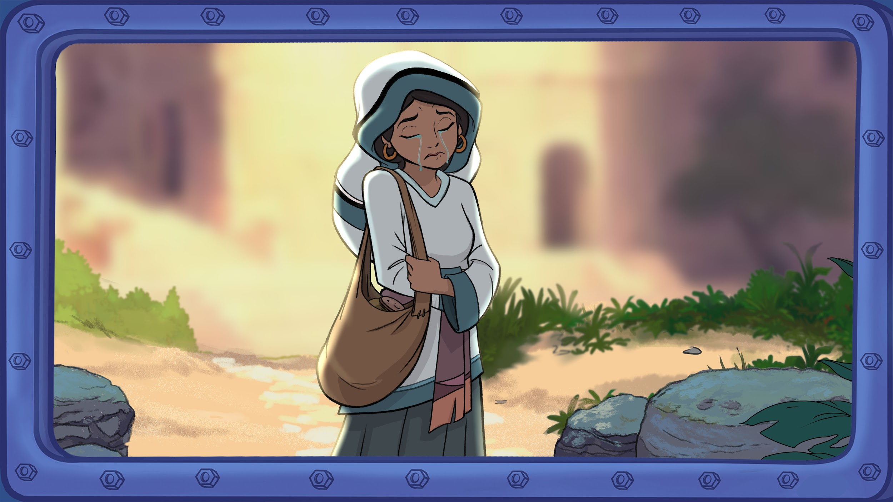
Notes:
Earlier that same morning… A very sad Mary went to visit Jesus’ tomb. She had been devastated since Jesus died. She had watched him perform miracles. She had heard him teaching about God. She knew Jesus was God’s Son. She believed he was the Messiah - the one who was sent to make everything right and good. And now (pause) Jesus was dead.

Slide 16
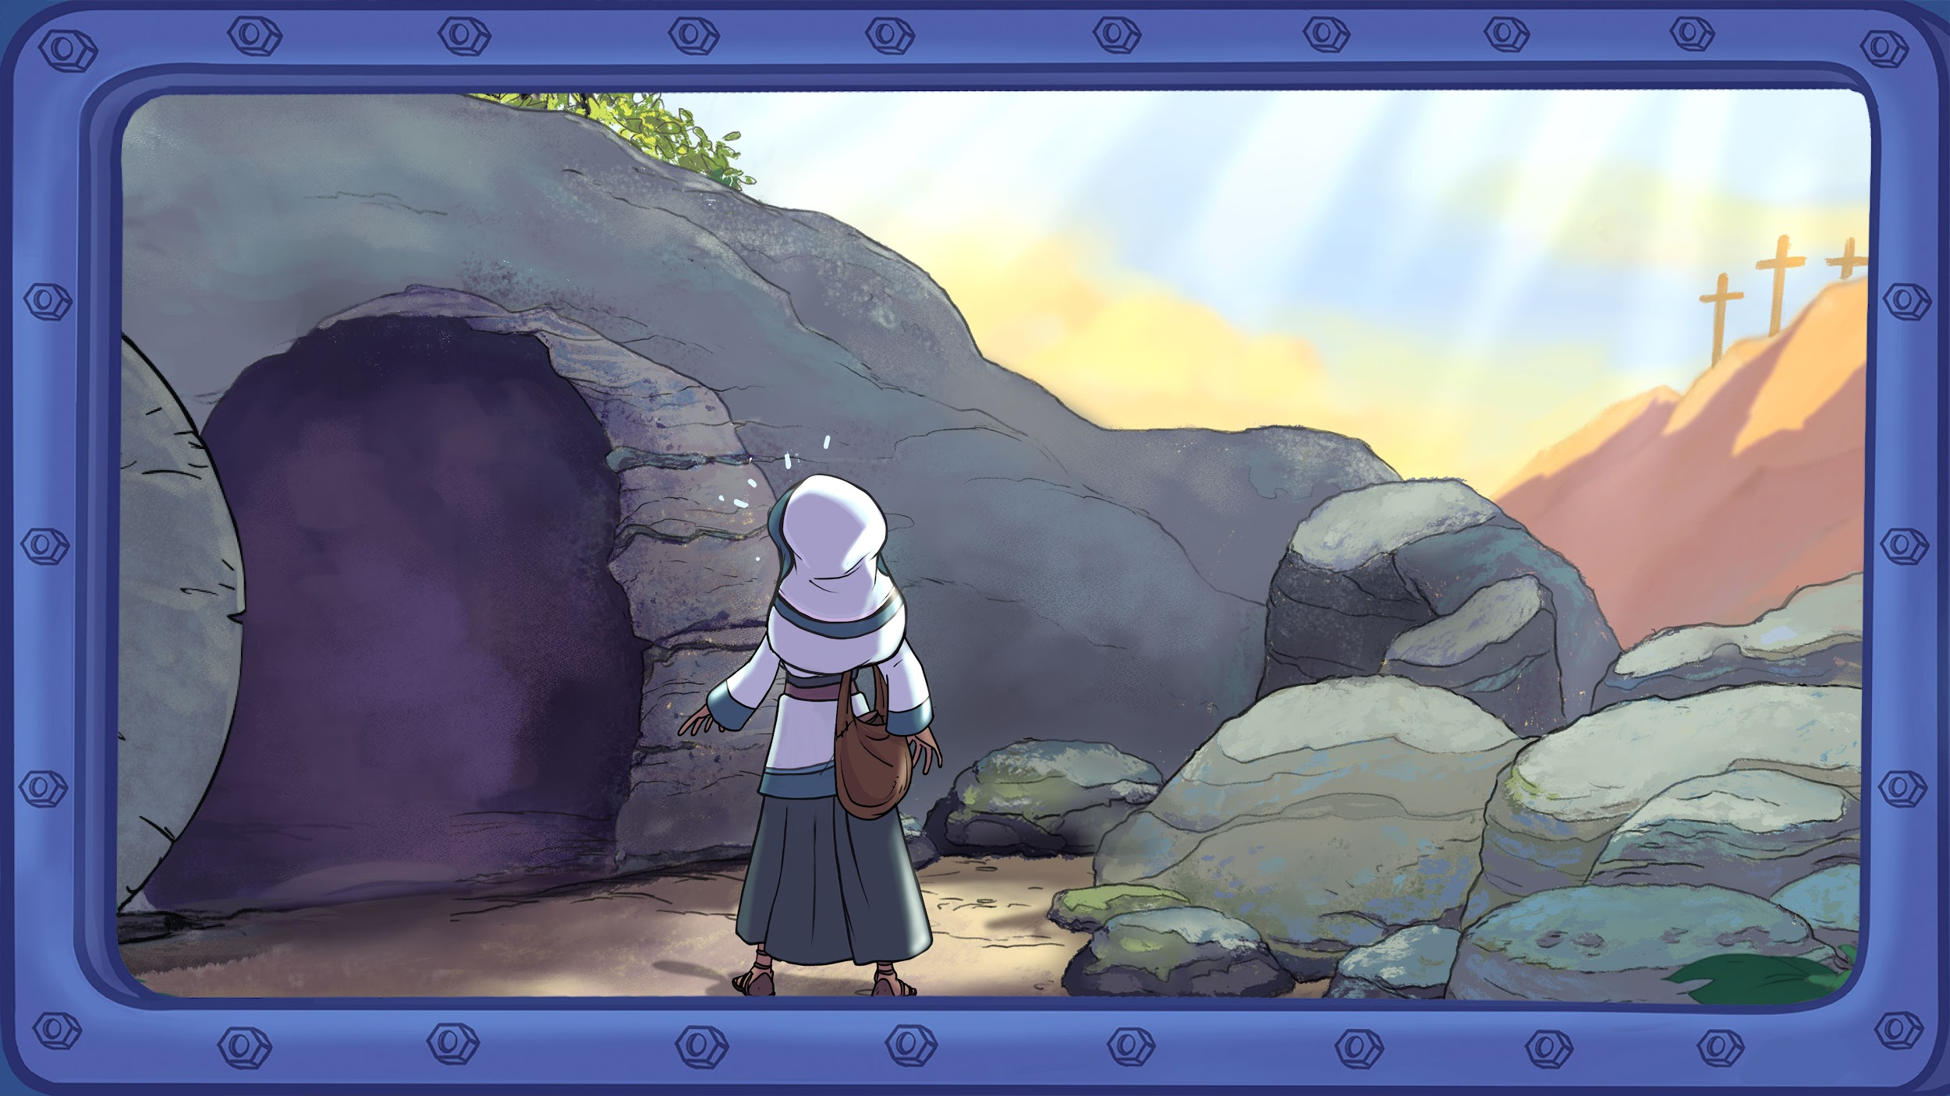
Notes:
Mary arrived at the tomb only to discover that Jesus’ body was not there! What??

Slide 17
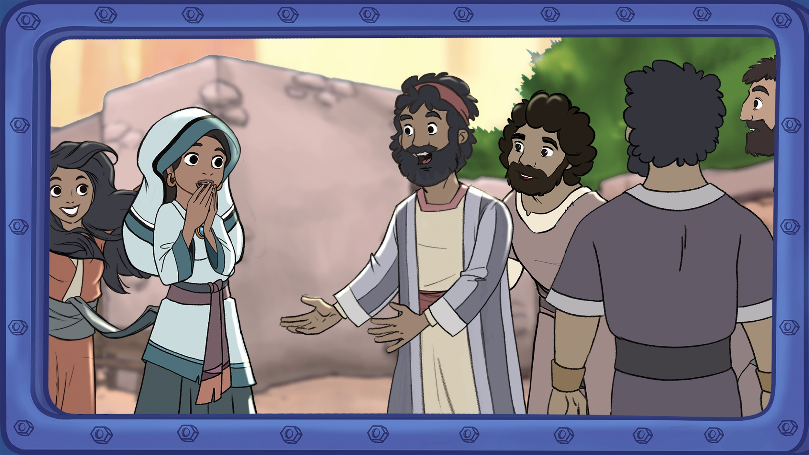
Notes:
Confused and shocked, Mary ran to see her friends. As she reached them her words tumbled out, 'They have taken the Lord from the tomb! I don’t know where they have put him!'

Slide 18
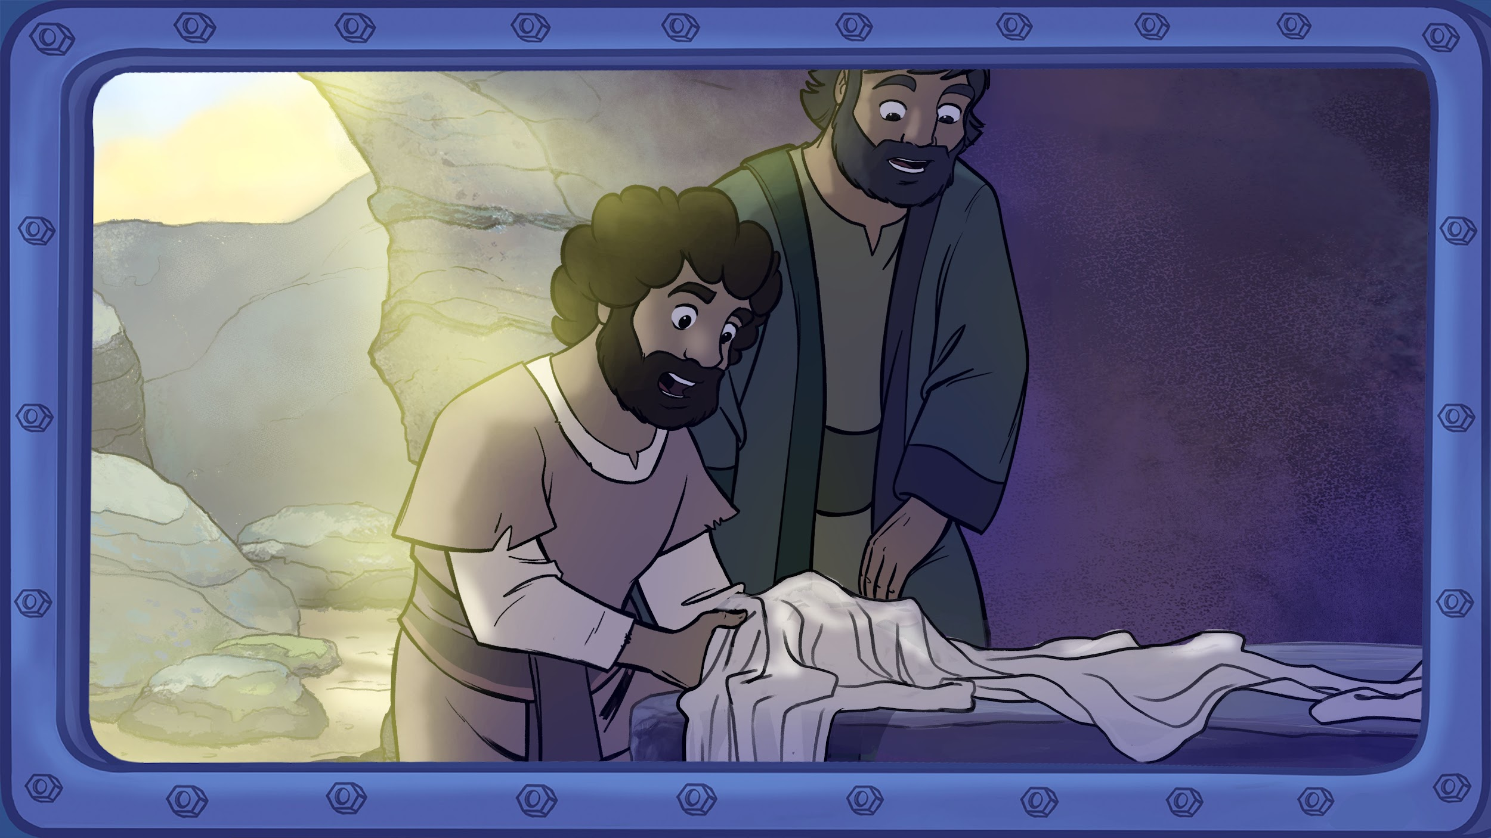
Notes:
Two of Mary’s friends – Peter and John – ran to the tomb; could they trust what Mary had said? Mary followed. When they arrived, not only was Jesus not there but Peter and John could see the clothes he had been wearing still in the tomb! Now they too were confused.

Slide 19
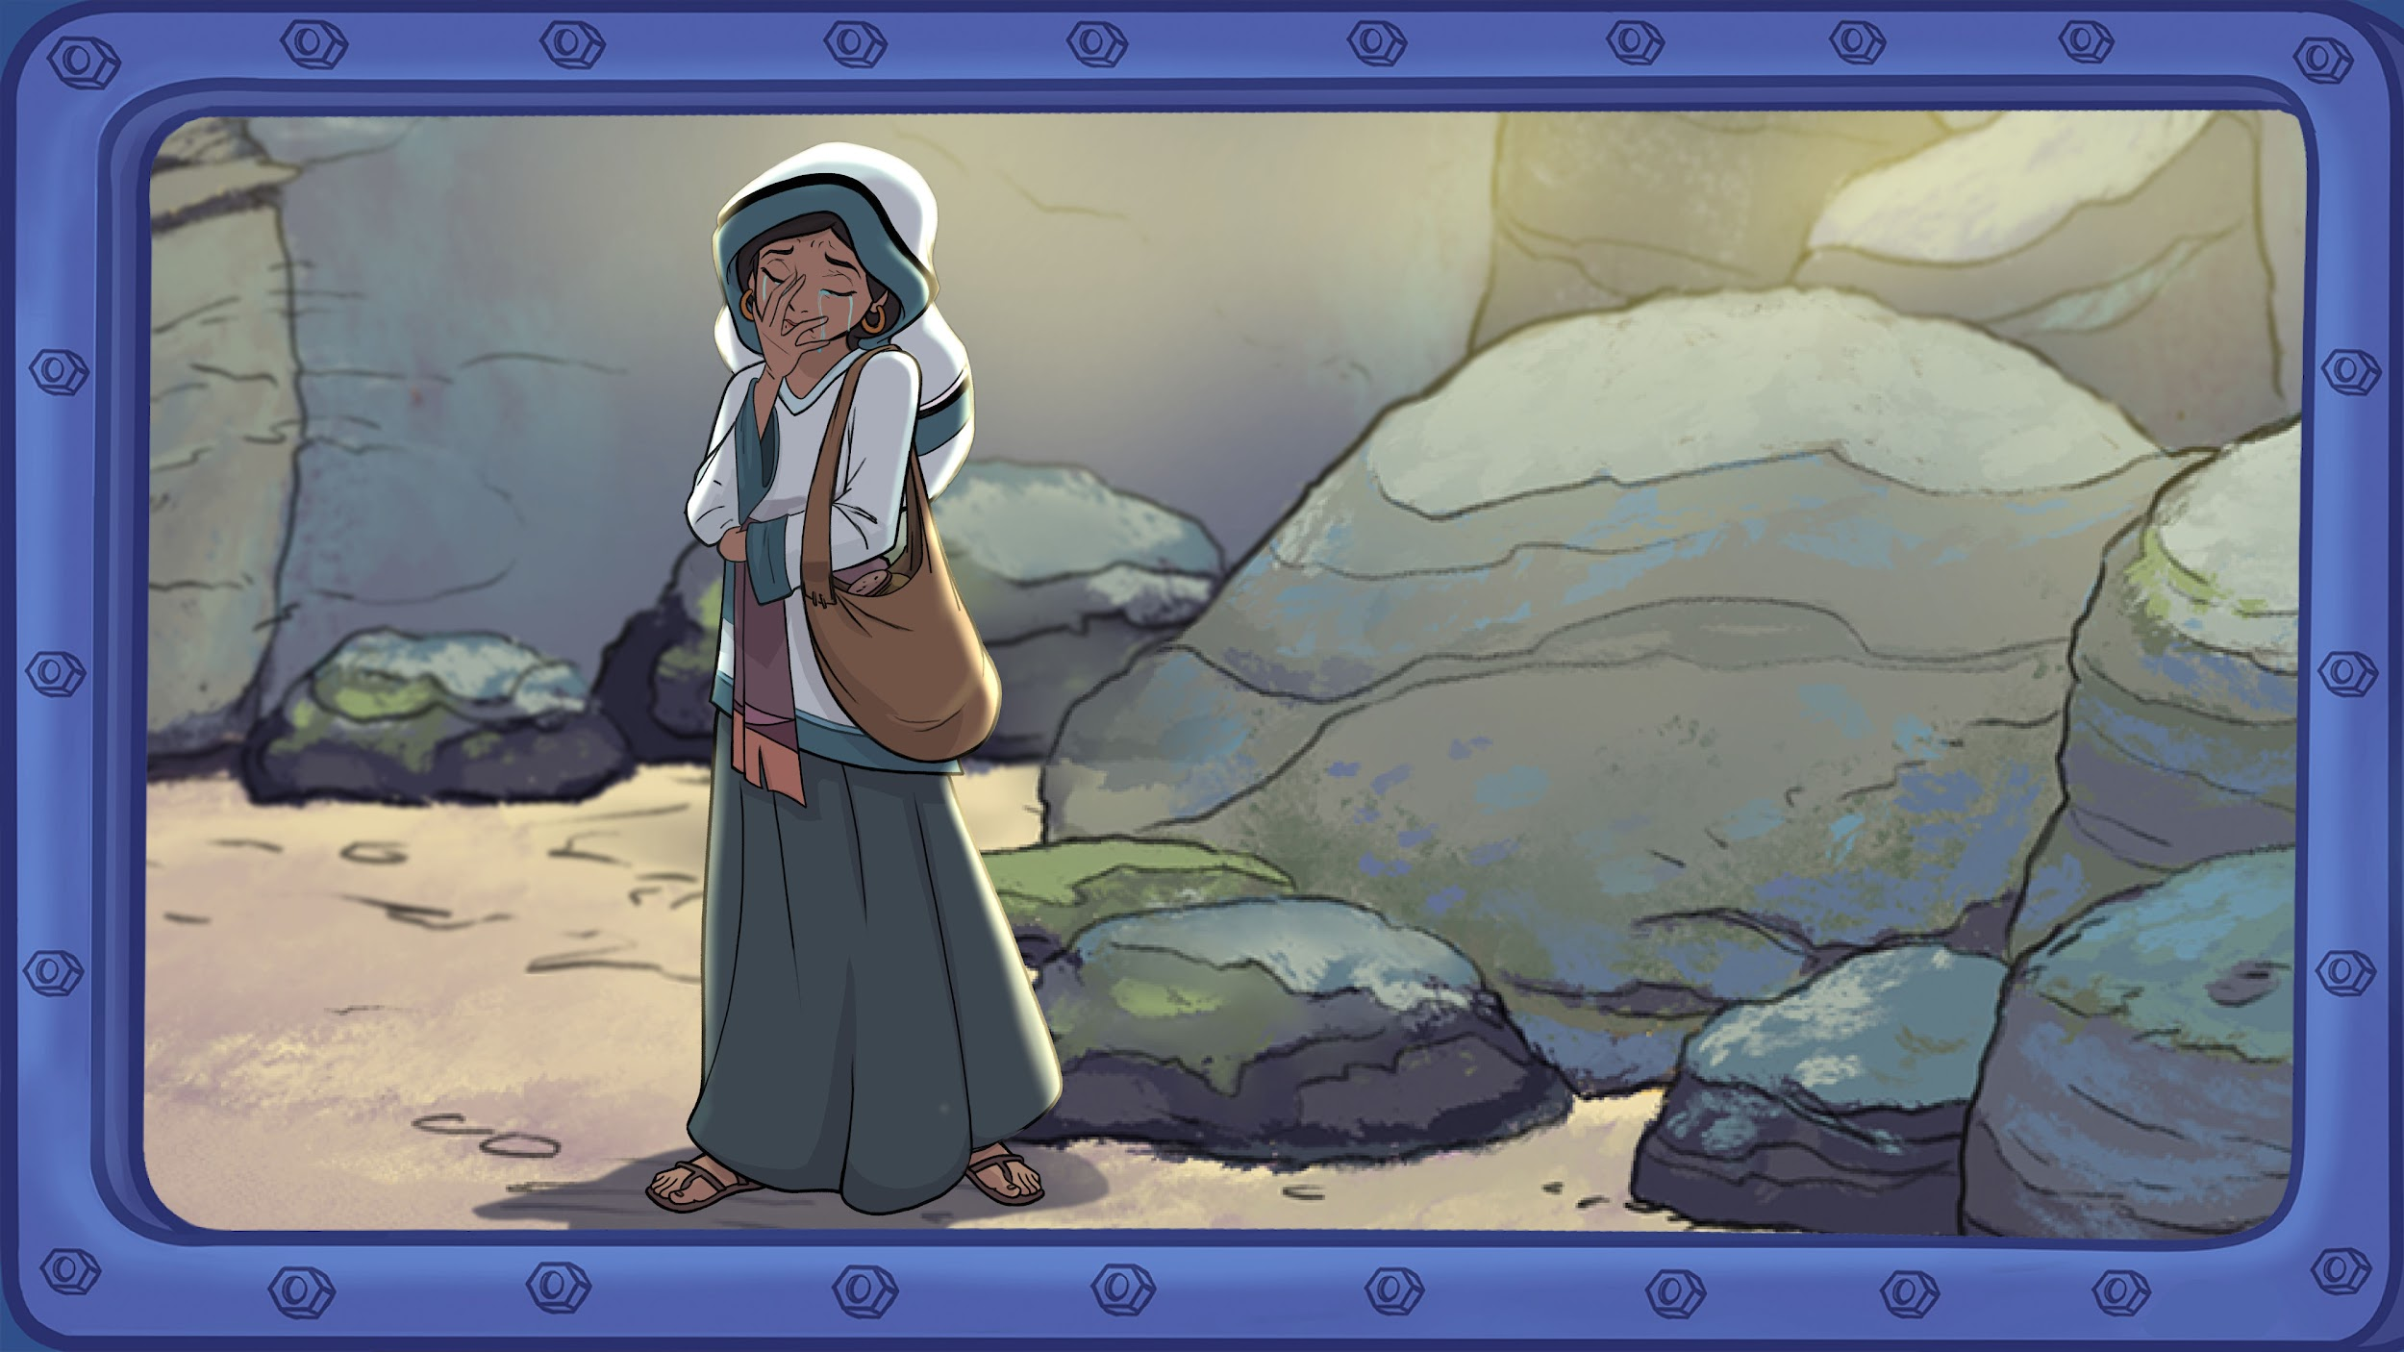
Notes:
Unable to understand what was happening, Peter and John went back to the other disciples, but Mary stayed. She cried and cried. She missed Jesus, and now this latest shock...it really was all too much. She stooped down to look into the tomb. And that’s when Mary got her next shock of the day…

Slide 20
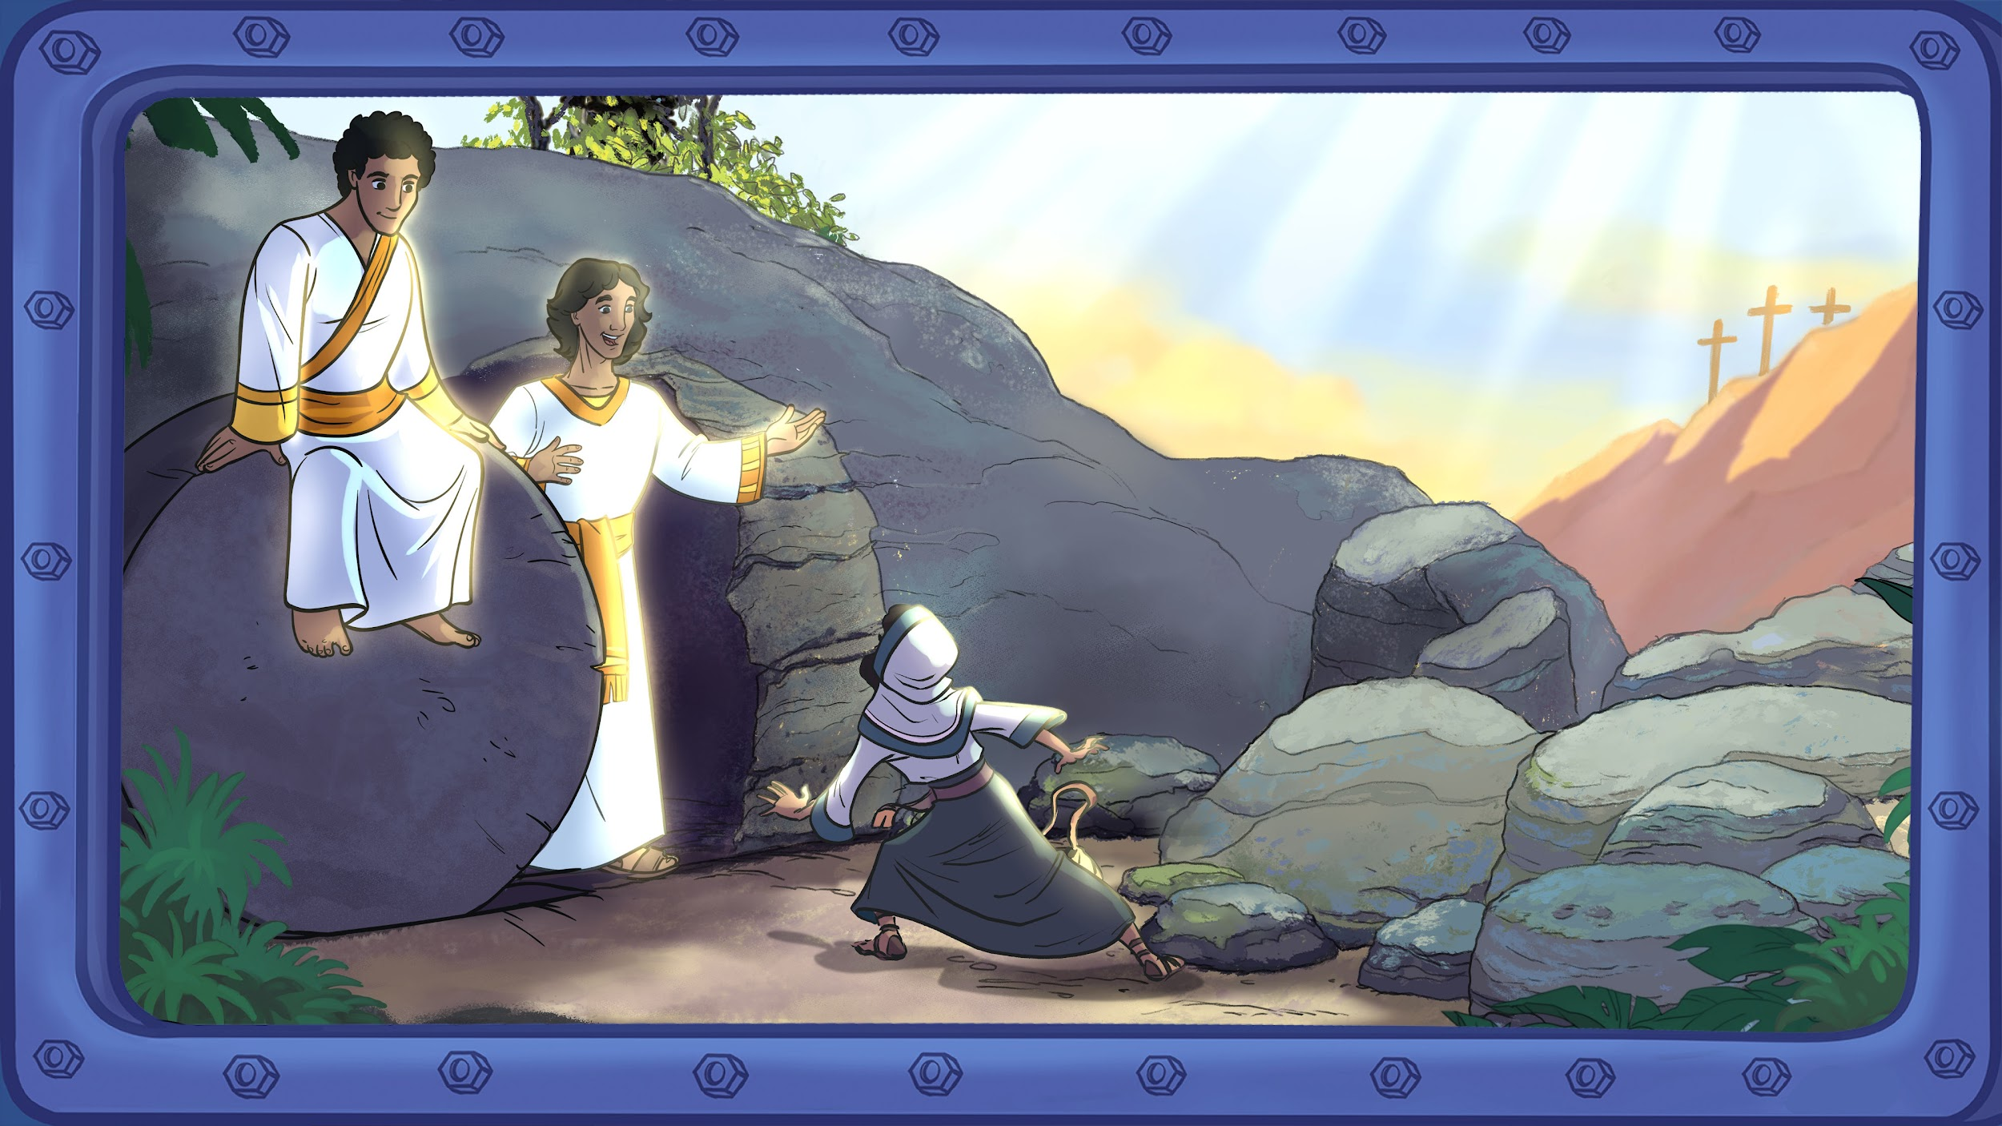
Notes:
...she saw two angels! They asked, 'Why are you crying?' She replied, 'They have taken away my Lord’s body! I don’t know where they have put him!’

Slide 21
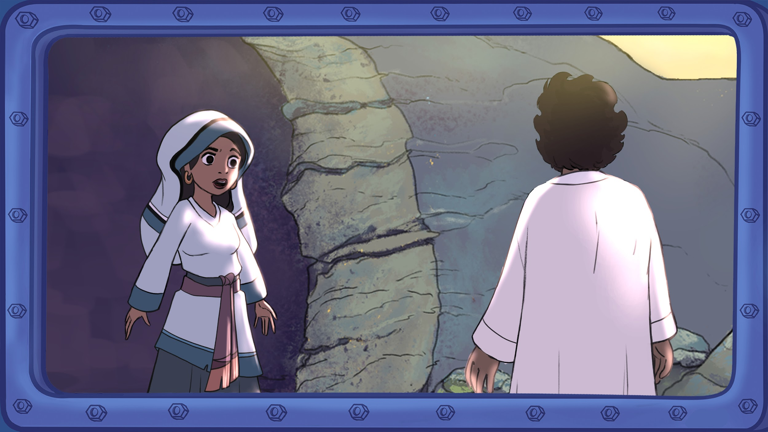
Notes:
Then she turned around. Mary saw another person that she didn’t recognise. This person asked her the same question; 'Why are you crying? Who are you looking for?'
‘Maybe’, Mary thought, ‘this man is the gardener. Maybe he moved Jesus’ body by mistake.’
So Mary sadly asked, 'Sir, if you have taken his body away, please tell me, so I can go and get him.'

Slide 22
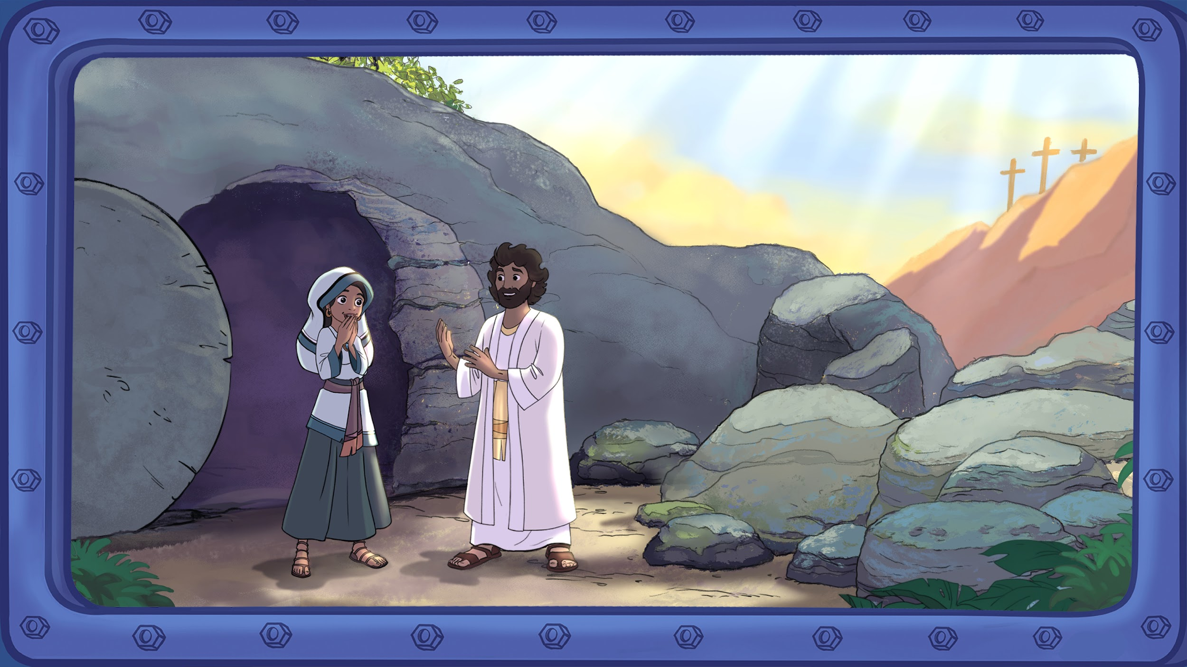
Notes:
The man said, 'Mary!'
Mary couldn’t believe her ears. Mary couldn’t believe her eyes. This man called Mary by her name! And Mary realised who the man was. He called her by name because he knew her, because he cared about her! It was Jesus!
Mary could now see and hear that Jesus was alive! And so, with tears of joy, she exclaimed 'Teacher!' and ran towards Jesus to hug him.
Jesus explained, 'Don’t hold on to me! I have not yet gone to the Father. But tell my disciples that I am going to the one who is my Father and my God as well as your Father and your God.'
Mary couldn’t believe it; Jesus was saying that she, Mary, could now be in God's family. She could now be friends with God!

Slide 23
Notes:
And so, early that Sunday morning, Mary ran towards her friends. Because Mary had extraordinary news to tell – Jesus, who had been dead, was now alive! And because Jesus was alive, she could be friends with God. And Mary was happy – she couldn’t wait to share the good news!

Slide 24
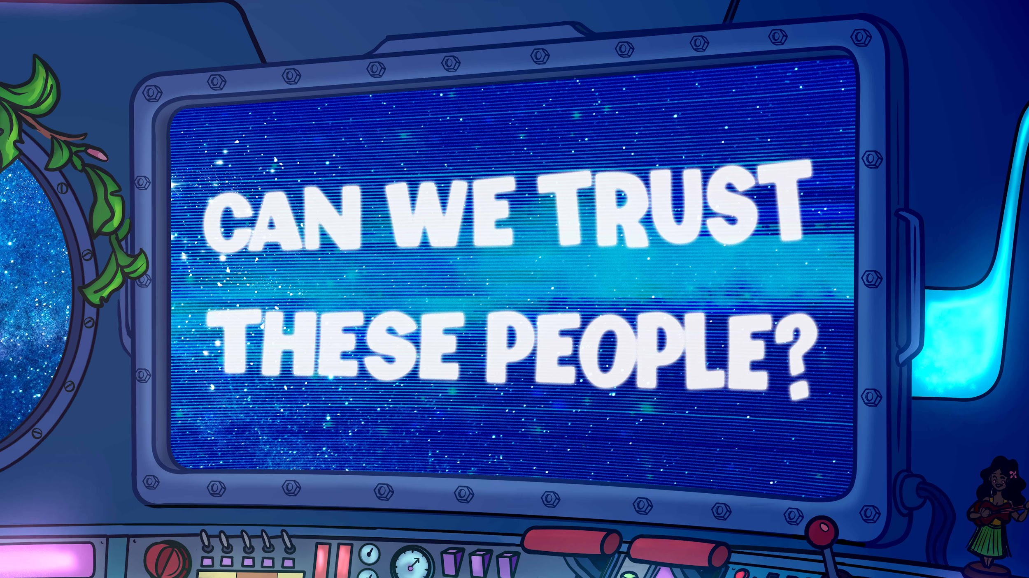

Slide 25
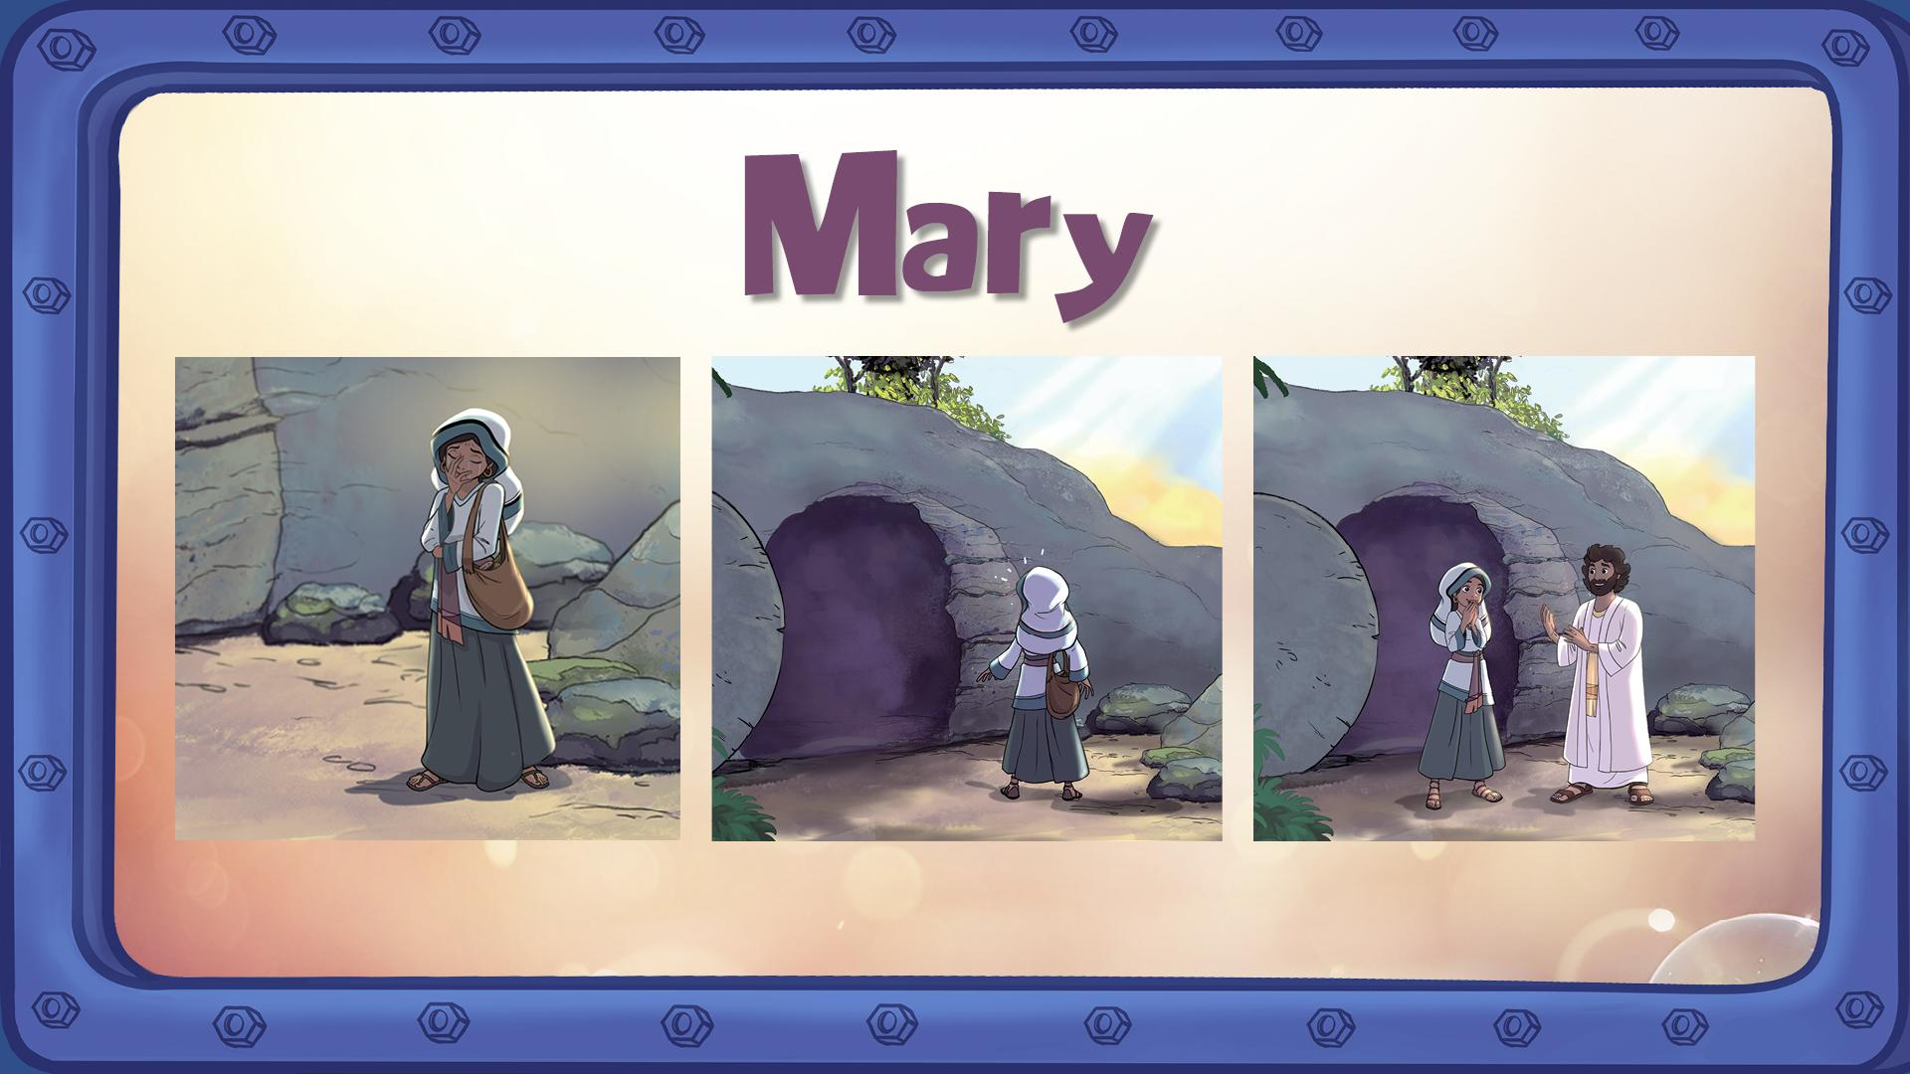
Notes:
Say: We can’t speak to the people in the Bible account – they all died long ago. But I believe there are good reasons to trust these accounts.
Ask: Why should we trust the account about Mary? (Allow students time to answer)
Say: Here are some good reasons: Mary had seen Jesus die. Mary wasn’t expecting to see Jesus alive – she said twice that she thought someone had taken the body.

Slide 26
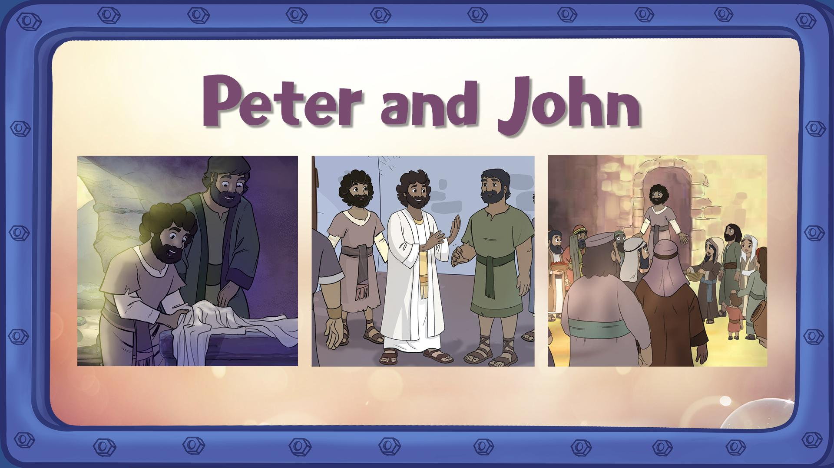
Notes:
Ask: Why should we trust the account about Peter and John? Here are some good reasons: The Bible shows that Peter went from a coward to a passionate spokesperson for Jesus. What do you think might have made him change? (He believed that Jesus was alive). John actually wrote this account. He gives many details that only an eyewitness would know.

Slide 27
